Slide 3
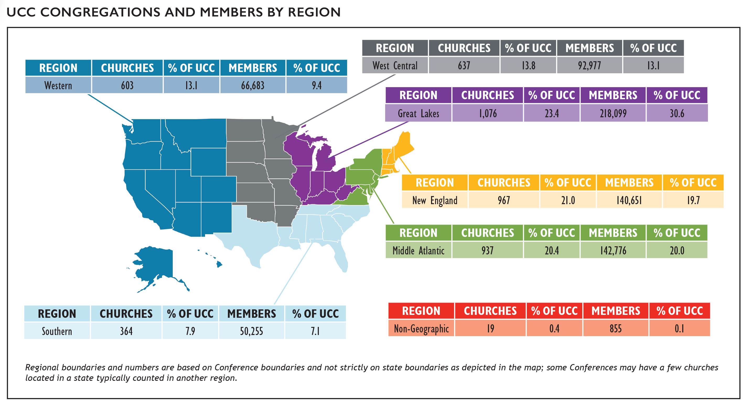
Congregations and Members
Notes:
At the end of 2022, there were 4,603 congregations in the United Church of Christ with a total of 712,296 members. The UCC’s congregations
represent about 1.3% of total U.S. congregations* while the membership of the UCC represents slightly less than one half of one percent
(0.44%) of total U.S. religious adherents* and about 0.21% of the U.S. population.** UCC membership is concentrated in the Great Lakes,
Middle Atlantic, and New England regions of the country.
*2020 U.S. Religion Census http://www.usreligioncensus.org/
**U.S. Census https://www.census.gov

Slide 4
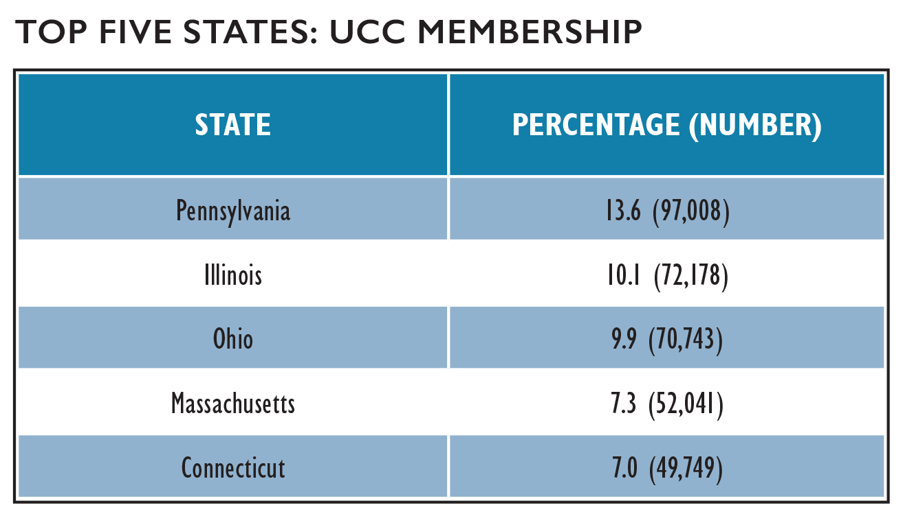
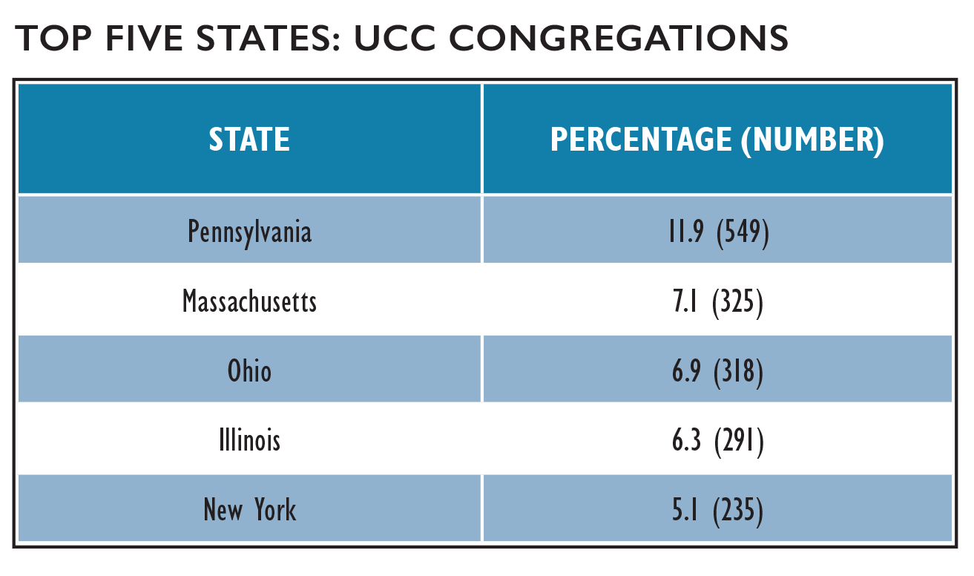
Congregations and Members
A detailed list of congregations and membership statistics by Conference can be found in the 2023 UCC Yearbook & Directory, p. 6.
Notes:
In examining the distribution of congregations by state, 11.9% of all UCC congregations were located in Pennsylvania, which reported the greatest number of congregations. In total, the top five states with the most congregations contained over one-third (37.3%) of all UCC congregations.
Membership, as with congregations, was concentrated largely in the Middle Atlantic, Great Lakes, and New England states. Nearly half of UCC members (48.0%) reside in the top five states by membership. Membership has become slightly more concentrated in these top five states over the past three years, with 47.1% of membership residing in these states in 2019. Notably, the churches in the states with the highest number of churches do not necessarily have the highest number of members. For example, Connecticut only has 4.8% of UCC churches, but has 7.0% of UCC members, while New York has 5.1% of UCC churches but only 3.8% of UCC members. This indicates that churches in Connecticut, on average, have a larger membership than churches in New York.

Slide 5
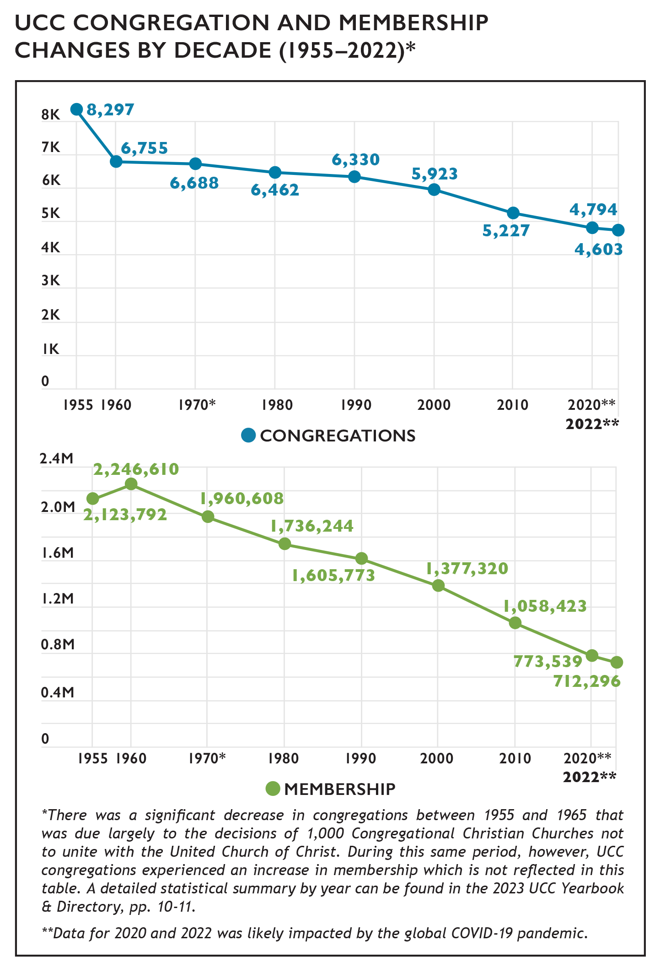
Growth and Decline
Notes:
Similar to other Protestant denominations, the UCC has experienced a decline in the numbers of congregations and members in recent decades. From 2012 to 2022 alone, the UCC encountered a net loss of 551 congregations and 286,610 members. Some of this decline, however, began prior to the formation of the denomination in 1957 as the number of congregations steadily decreased despite membership increases in the UCC’s early years.
In 2022, 128 congregations were removed from denominational records. This was a 50.6% increase from 2021, when 85 congregations were removed from denominational records; some of this increase over 2022 is related to a new policy from the UCC’s Board of Directors that removes churches from records after two years of being marked inactive unless the Conference requests an extension or otherwise updates an inactive designation. Since this was the first year the policy was enacted, the number of inactive churches removed is not expected to be as high in subsequent years; future years of data collection will demonstrate whether removals return to previous levels: 72 in 2020, 43 in 2019, 85 in 2018, and 74 in 2017. From 2005 through 2007, the UCC experienced a loss of nearly three congregations per week on average (mostly as a result of General Synod’s resolution regarding same-sex marriage). Resulting from the higher number of churches removed in 2022, the loss rate was higher than previous years—2.45 congregations removed from denominational records per week on average. While this rate was higher than in 2021 (1.63 congregations per week), the rate remains below that of 2005–2007.
Over the past year, 6 congregations have been added to denominational records (this includes churches that received standing, affiliated, or merged with another congregation), which is a decrease over the prior year, when 15 congregations were added. In total, 57 congregations received standing and were added to the UCC over the last five years, which is equivalent to a new congregation being added about every month.

Slide 6
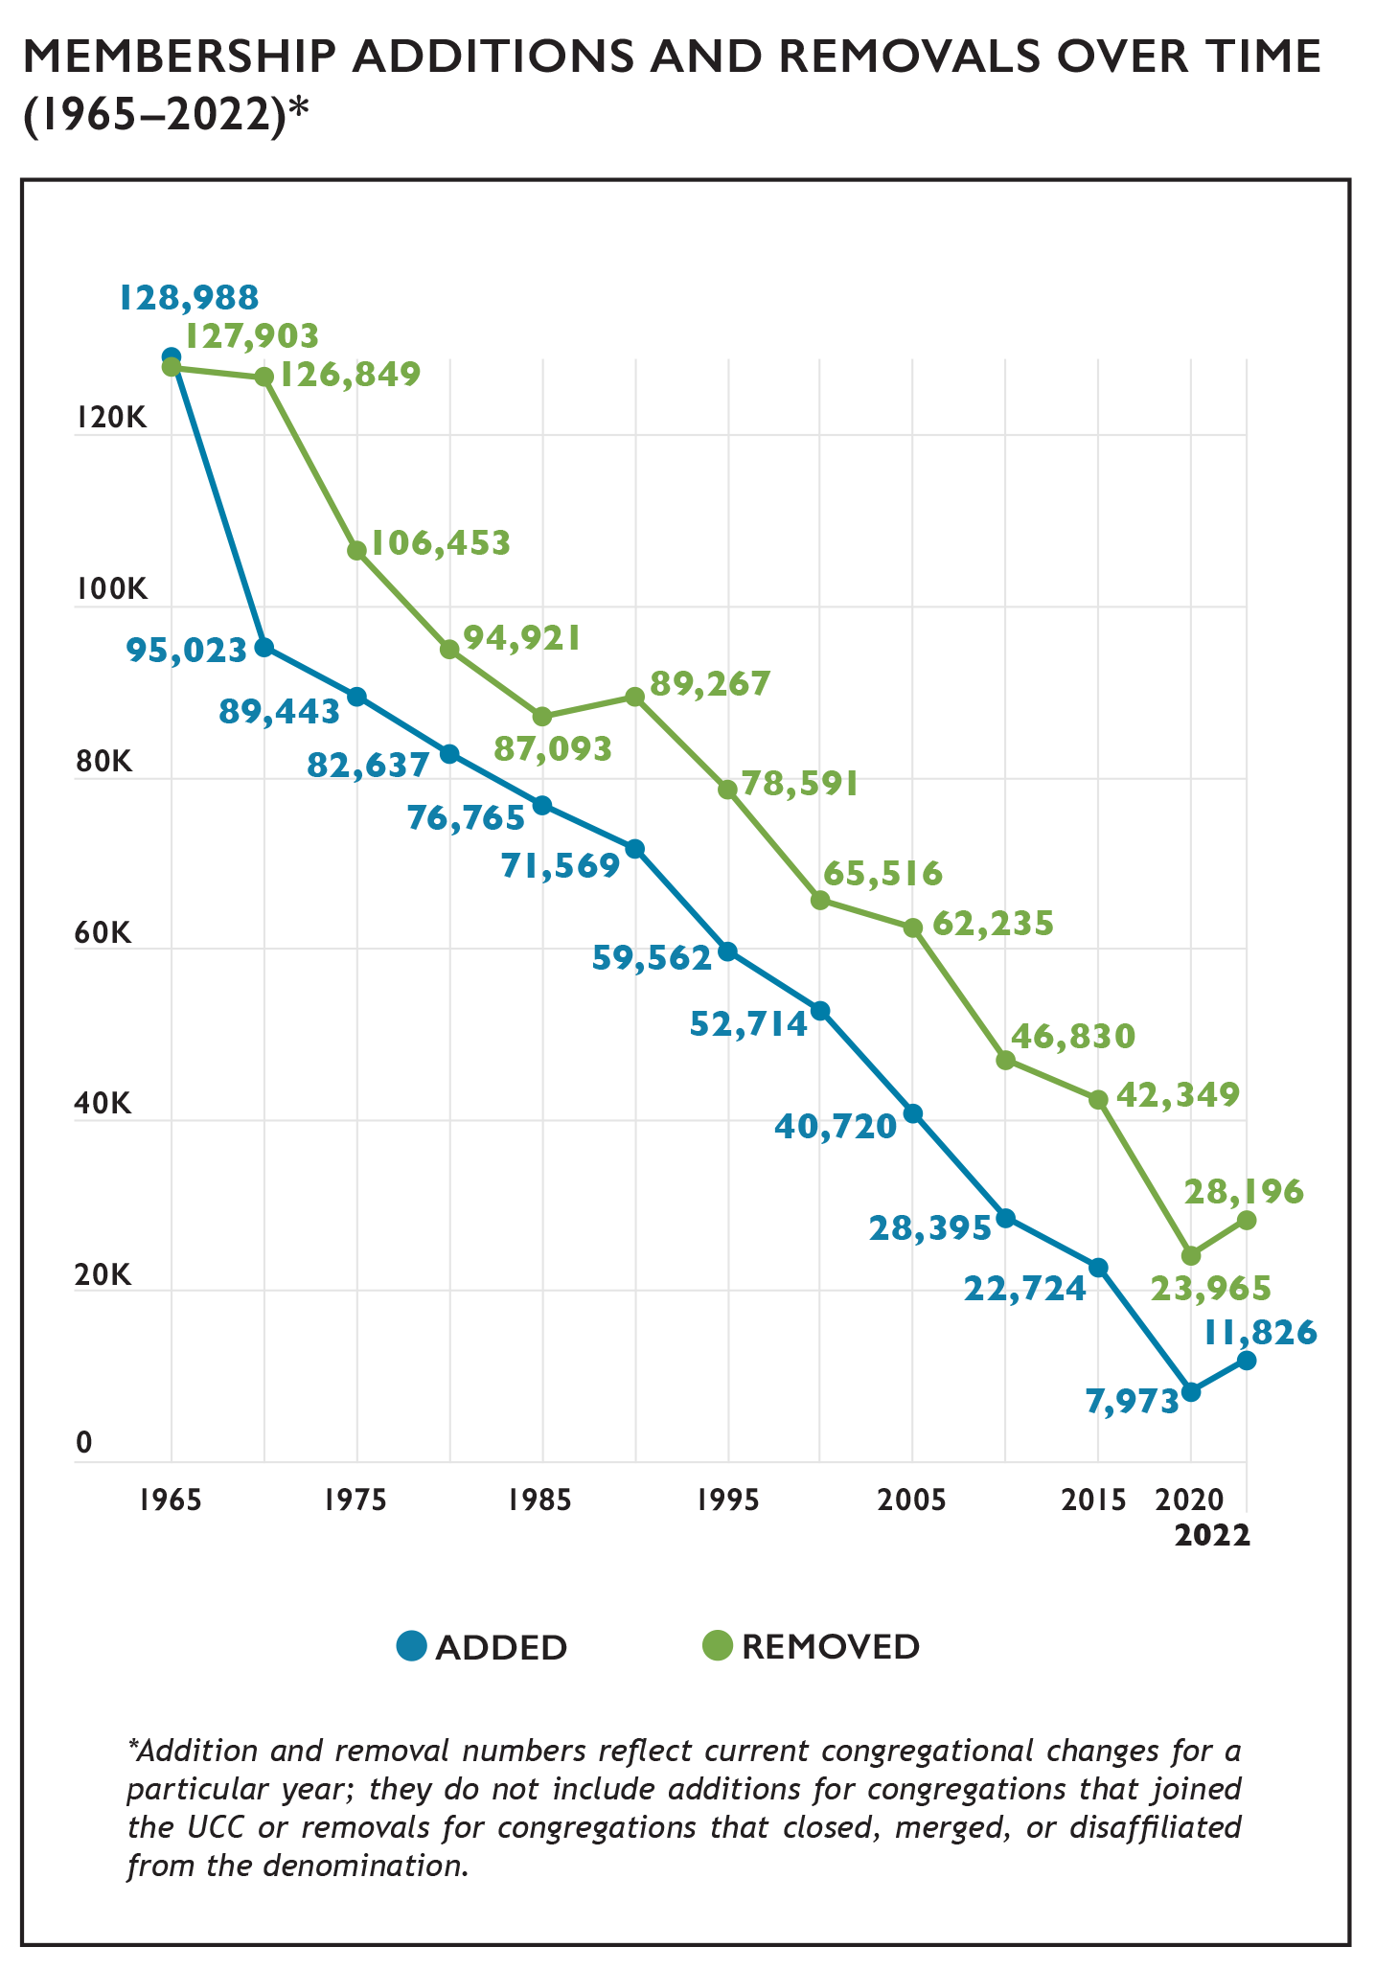
Membership Growth and Decline
Notes:
In general, the number of members removed each year exceeds the number of members added for that same time period. Members are removed from congregational records for several reasons including death, transfer of membership to another denomination, or updating of local church membership records.
The net difference between UCC members added and removed from congregational membership rolls has continued to decline as total membership has decreased. In 2022, there was a net removal of 16,370, which is similar to last year (16,454) and less than earlier points in the 2010s (19,625 in 2015 and 18,435 in 2010). (Note that net loss figures represented here are different than the net change figure represented in the UCC Yearbook & Directory, which is based on total membership.) Over time, the number of members added and removed have both declined although the net loss contributing to this decline has generally become smaller. Smaller numbers of members were added in 2020 (7,973) and 2021 (8,421) compared to other years—likely an effect of the COVID-19 pandemic—but this trend reversed in 2022 with 11,826 members added, possibly a reflection of new ways of attracting and including members through virtual worship.

Slide 7
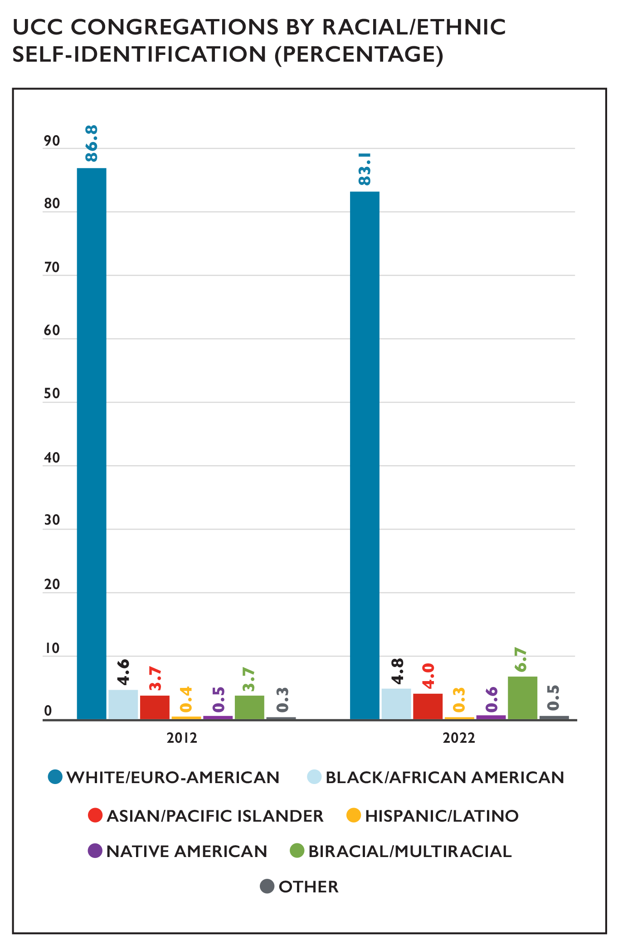
Congregations by Race/Ethnicity
Notes:
A substantial majority of congregations in the UCC self-identify as White/Euro-American (meaning that most members of a congregation belong to that particular racial/ethnic group). Over time, however, the UCC as a whole is becoming more racially/ethnically diverse. Over the last decade, the percentage of self-reported primarily White/Euro-American congregations decreased from 86.8% in 2012 to 83.1% in 2022. During this same time frame, the percentage of Biracial/Multiracial congregations increased from 3.7% in 2012 to 6.7% in 2022 and Other congregations increased from 0.3% to 0.5%. In addition, the percentage of Black/African American and Asian/Pacific Islander congregations each increased by 0.2% and 0.3%, respectively, during this time period. The proportion of Native American congregations also increased slightly, from 0.5% to 0.6%. One cause of these shifts over time may be due to the fact that the majority of congregations that close, merge, or disaffiliate with the denomination are primarily White/Euro-American congregations, thus decreasing the overall proportion of these congregations, while newer UCC congregations tend to be more racially/ethnically diverse.

Slide 8
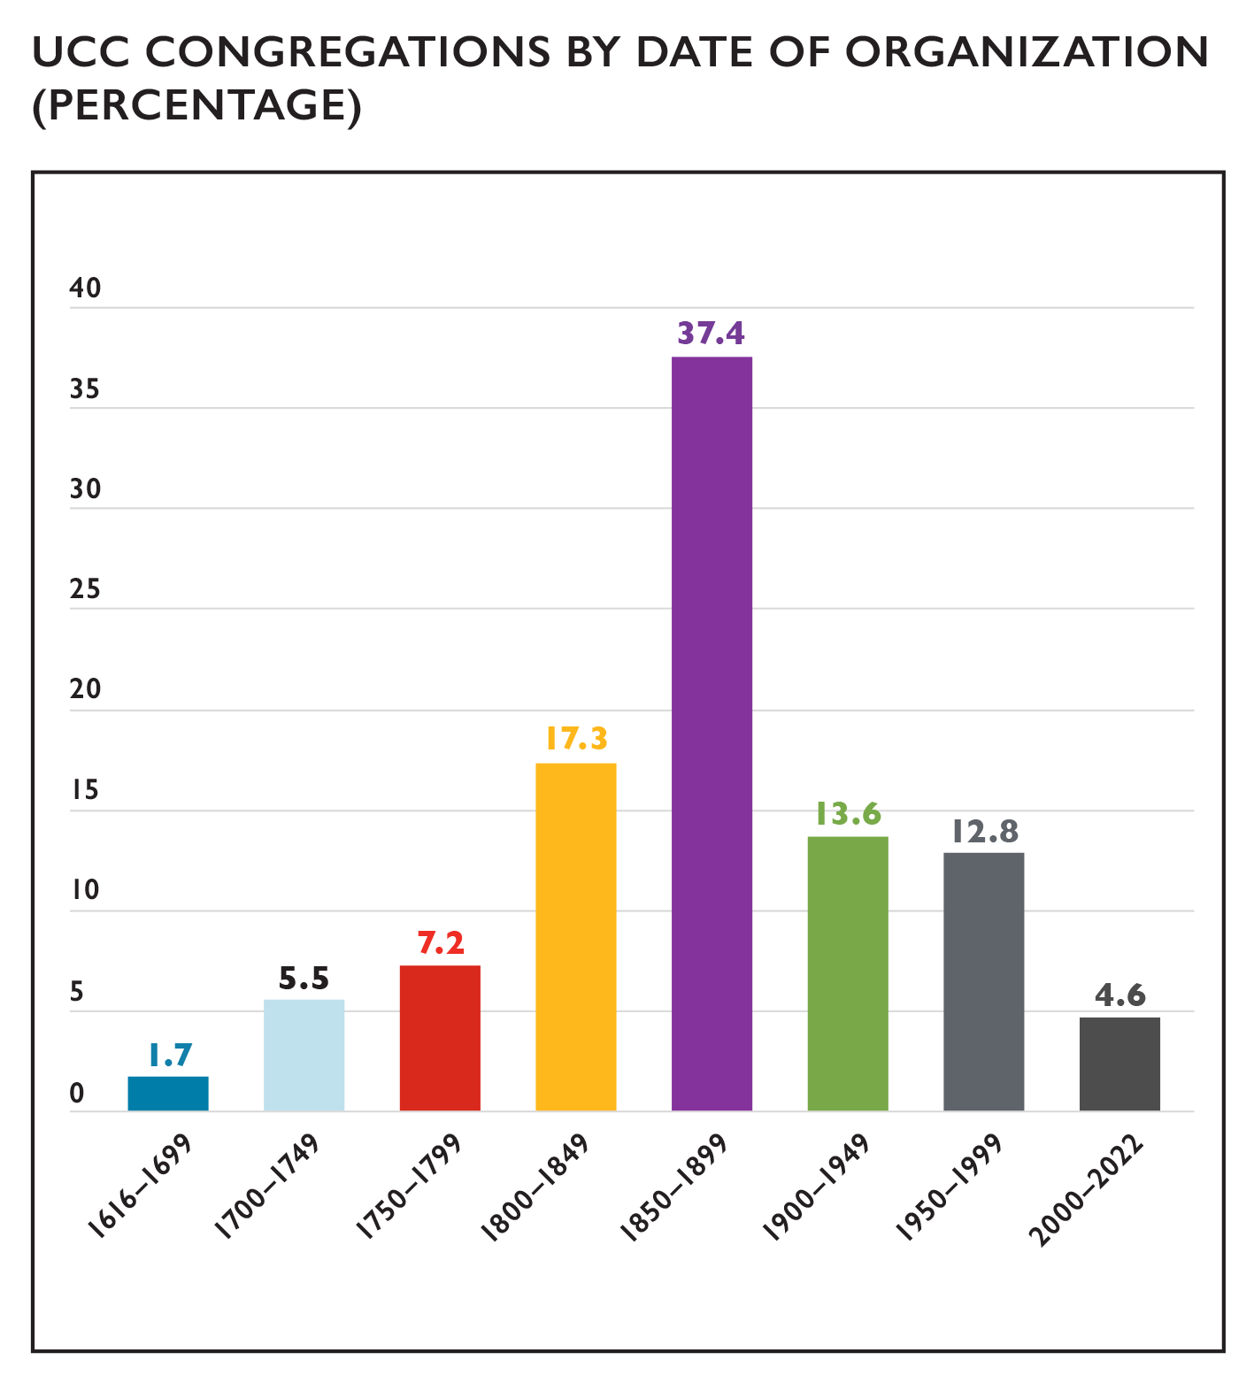
Congregations by Date of Organization
Notes:
While the UCC has only been in existence since 1957, many of its congregations were founded by predecessor denominations. The vast majority of churches (85.0%) were organized before the UCC’s founding year. The latter nineteenth century (1850-1899) was the most common founding era for UCC churches while just under 1 in 20 UCC churches (4.6%) has been founded in 2000 or later, a percentage that has been increasing steadily. The average founding date of congregations is 1873 while the median founding date is 1874.

Slide 9
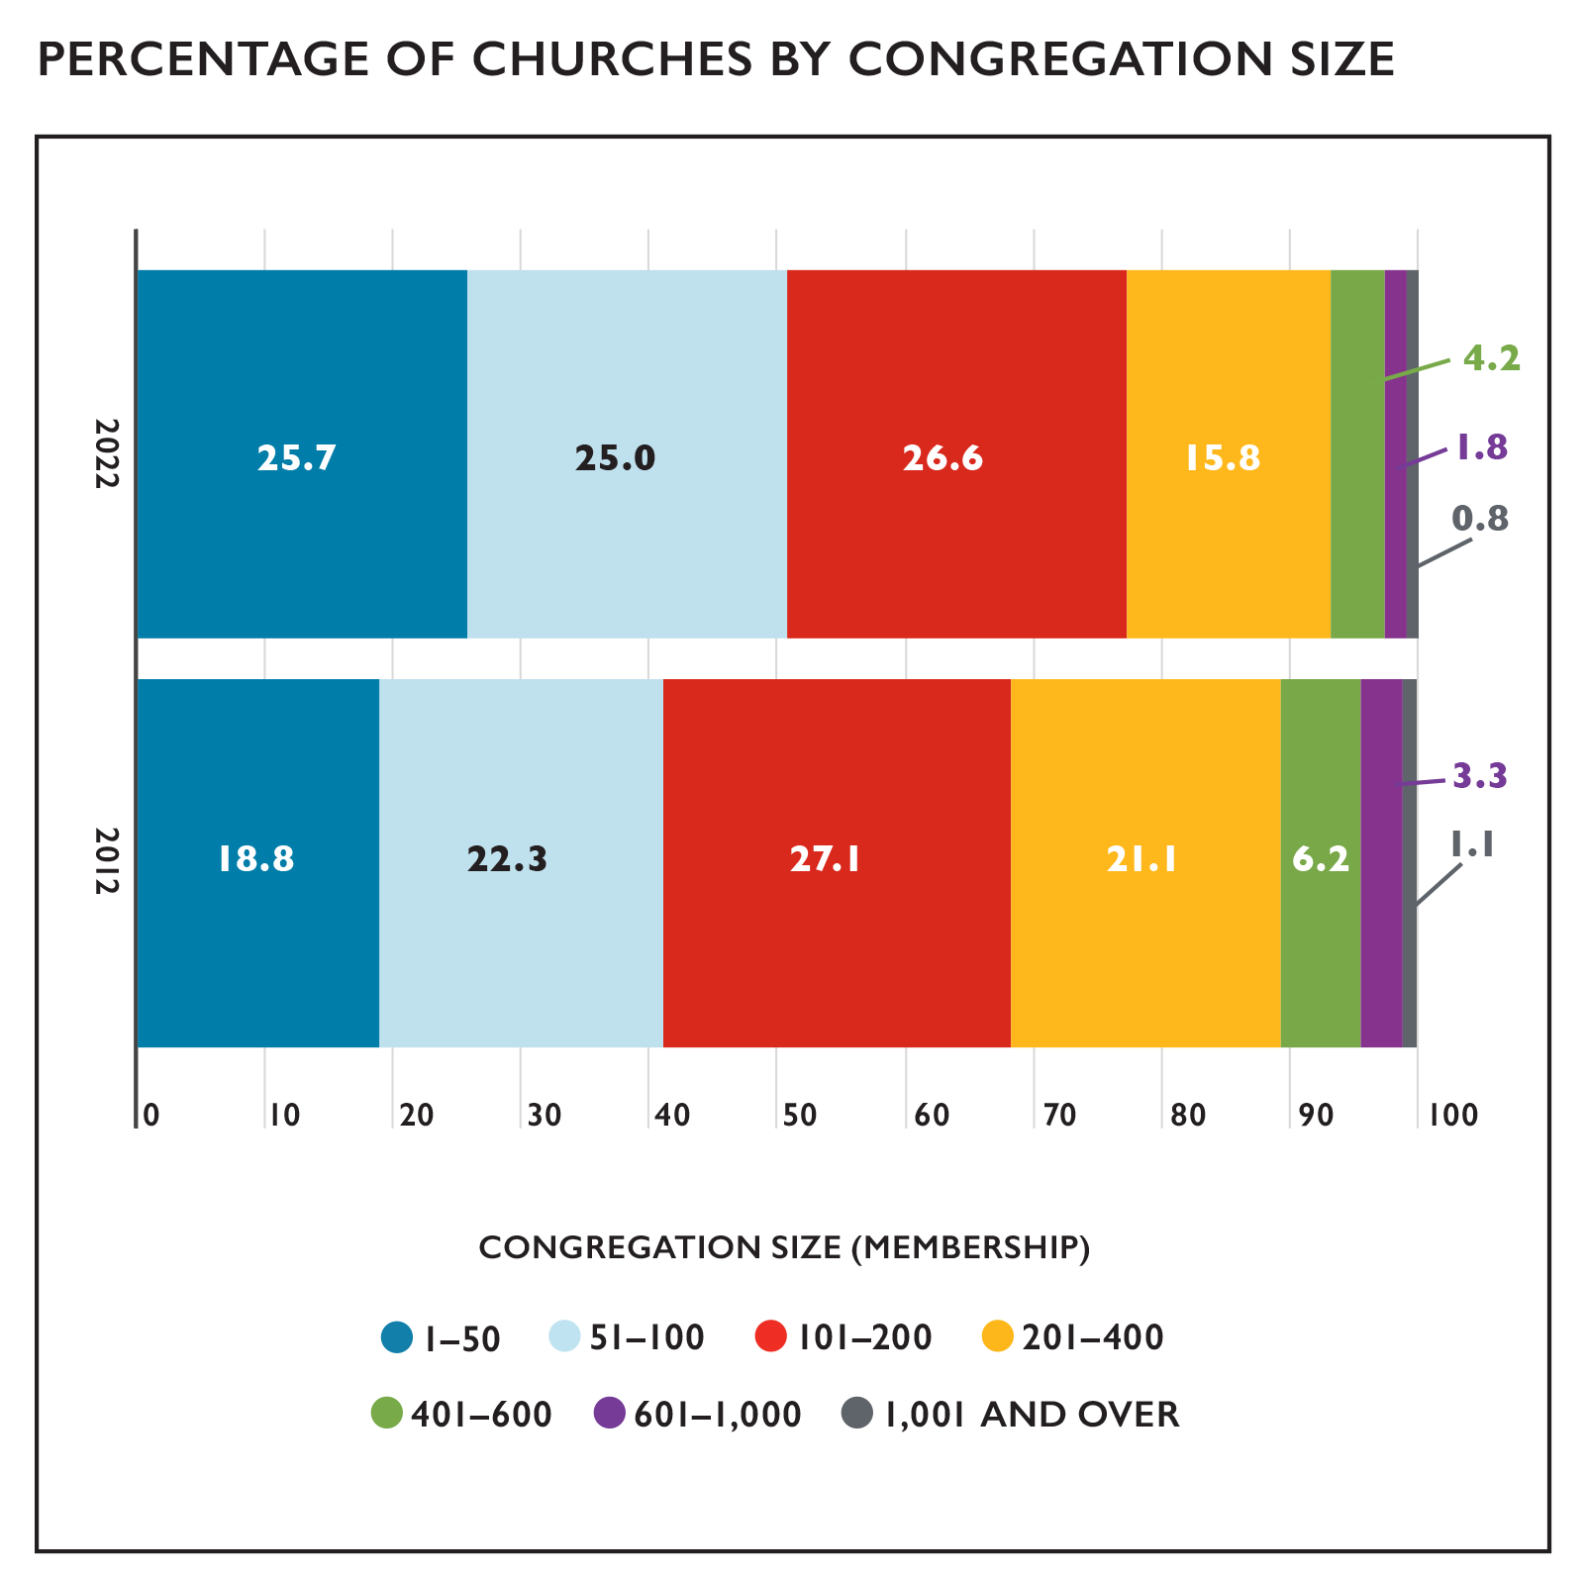
Congregation Size by Membership
Notes:
The vast majority (93.1%) of UCC members belong to congregations with 400 or fewer members with half (50.7%) attending congregations with 100 or fewer members. This reflects an overall trend within the UCC of membership being increasingly concentrated in smaller churches; in 2012, 89.3% of UCC members belonged to churches with 400 members or fewer and 41.1% belonged to churches with 100 members or fewer. The biggest changes in the past 10 years have been in churches with less than 50 members, which have increased from 18.8% to 25.7% of members since 2012, and churches with 201-400 members, which have decreased from 21.1% to 15.8% of members since 2012.

Slide 10
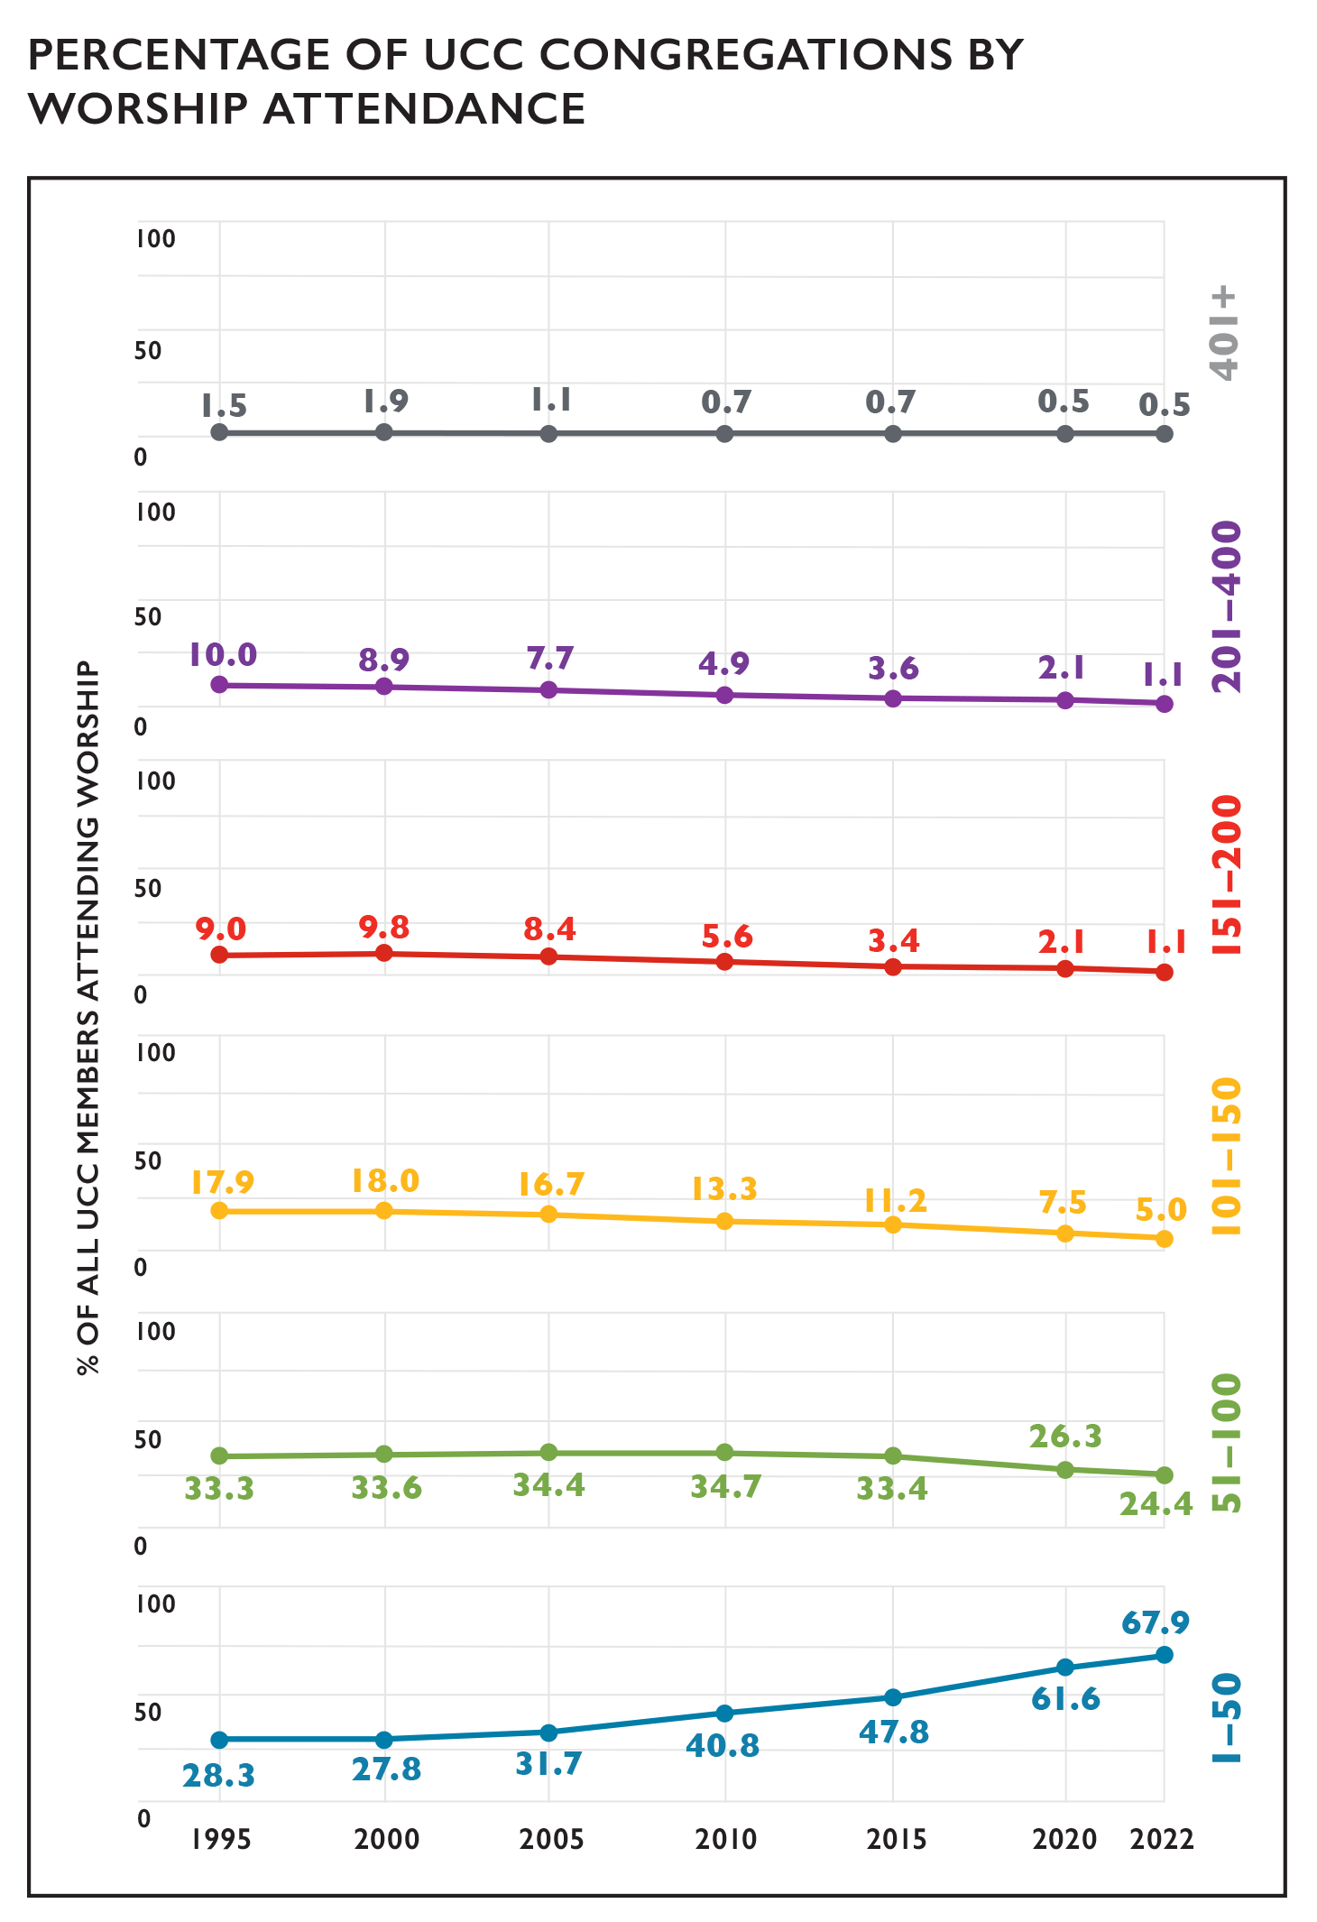
In-Person Worship Attendance
Notes:
When considering worship attendance figures rather than membership size, even more congregations are categorized as smaller churches. In 2022, over 90% of churches in the UCC (92.3%) had a weekly worship attendance of 100 or fewer, which is 16.8% higher than in 2010 and 30.9% higher than in 2000. Over time, the percentage of congregations in the highest worship attendance categories has decreased steadily, with the most dramatic decreases occurring in congregations of 101-400 worship attenders since 1995—from 36.9% of congregations with worship attendance in this range in 1995 to 7.0% of congregations in 2022. As a result, over two thirds (67.9%) of all UCC congregations now have a weekly worship attendance of 1-50 individuals.
While these shifts toward smaller worship attendance have been present for decades in the UCC, the restrictions on gathering size many churches faced for in-person worship during the COVID-19 pandemic may be partly responsible for the increases in the 1-50 category specifically in 2020 and 2021. Also, the widespread practice of virtual worship during the pandemic may have also impacted in-person worship attendance patterns. For information on virtual worship attendance in 2022, please see page 31.

Slide 11
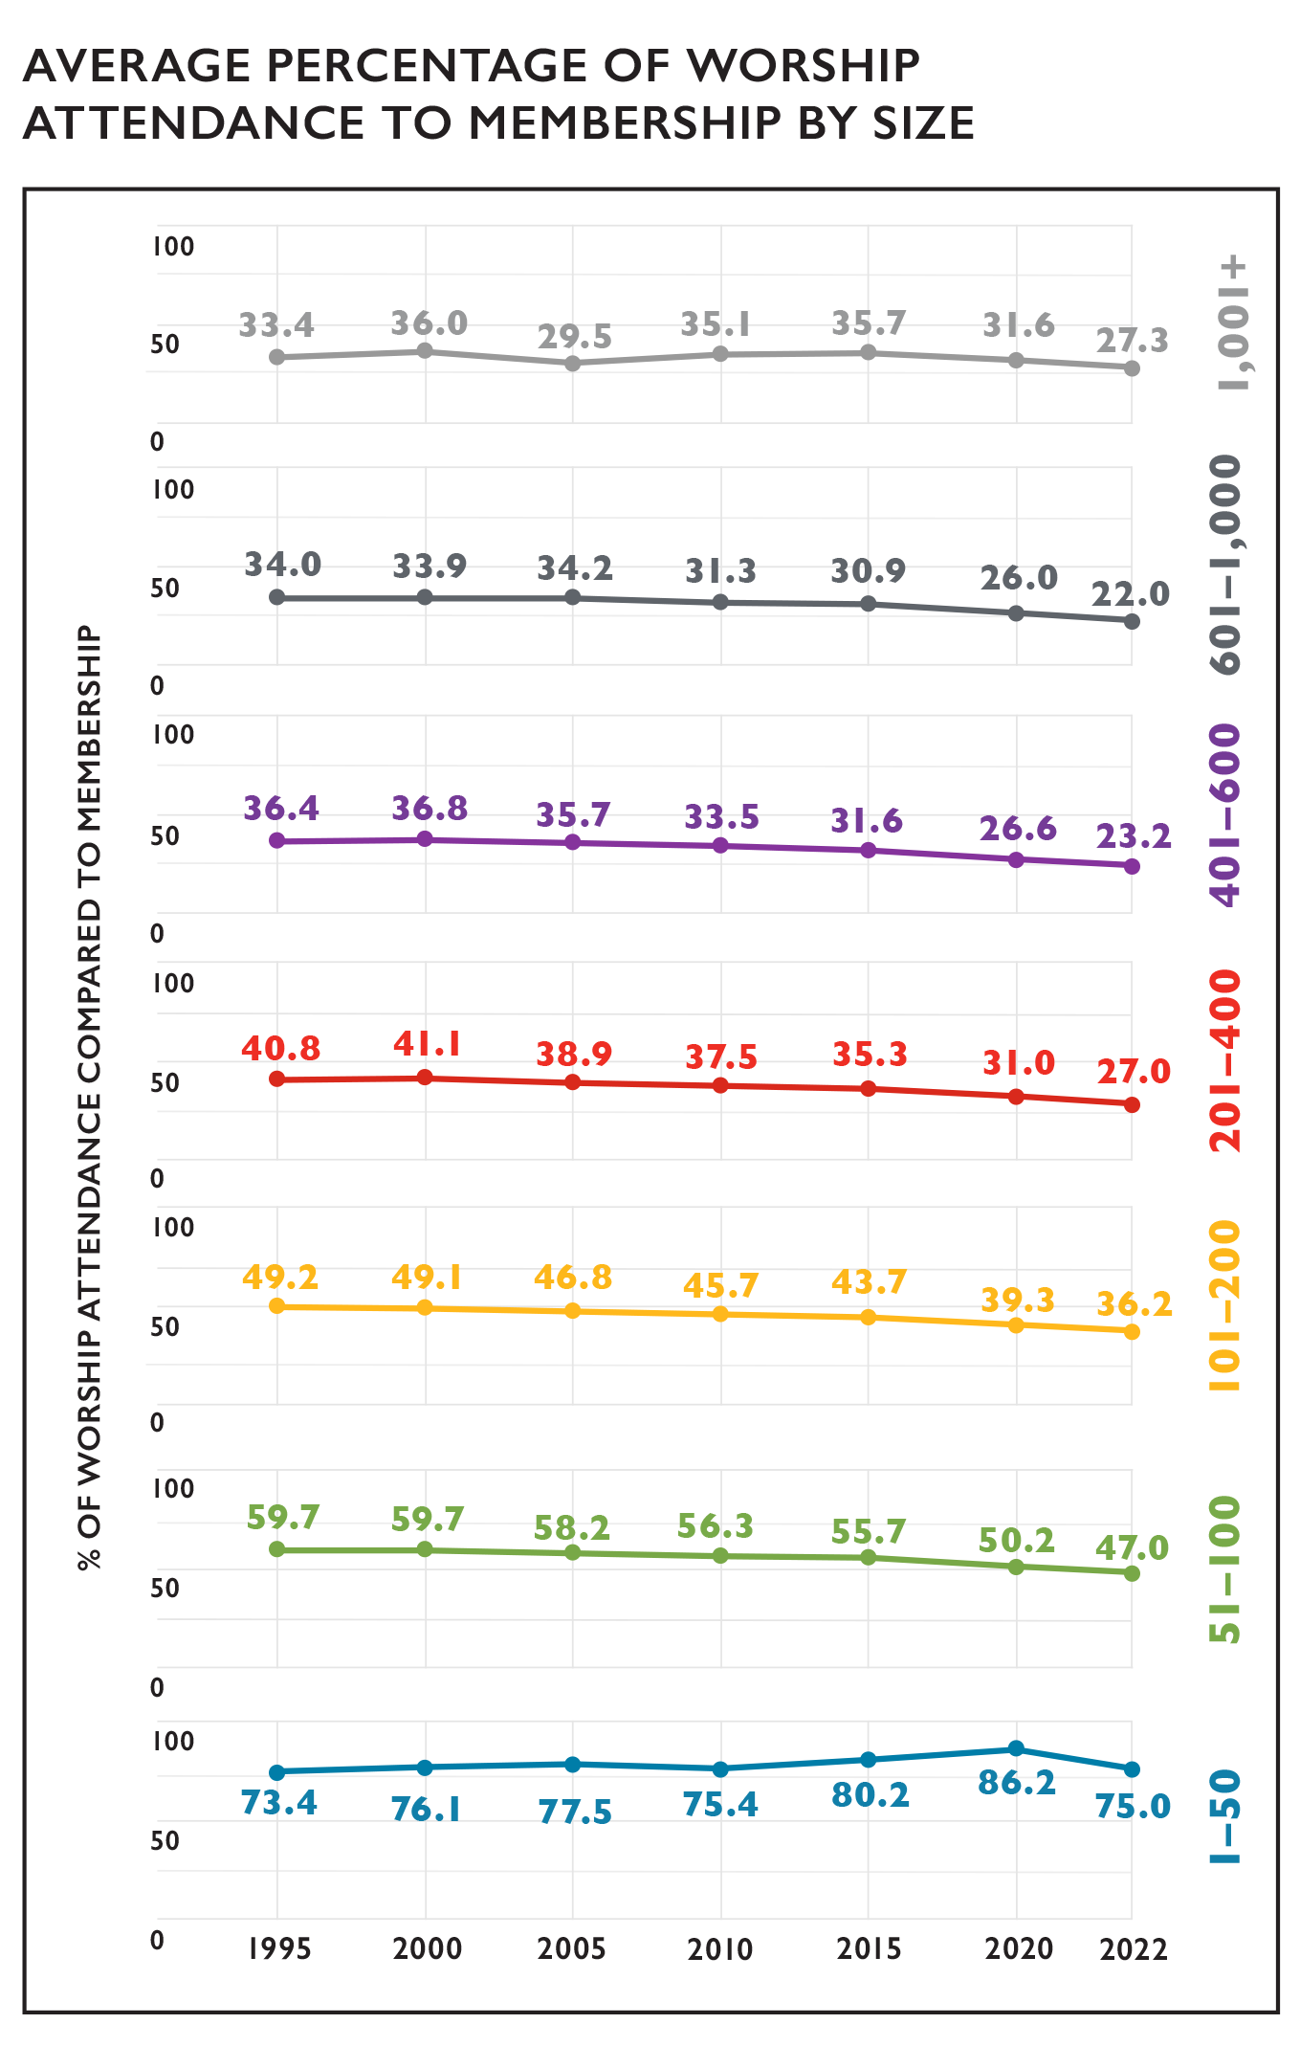
In-Person Worship Attendance and Membership
Notes:
The relationship between in-person worship attendance and membership continues to shift incrementally over time. From 1995 to 2022, the proportion of people attending in-person worship services compared to membership has notably declined, with two exceptions—the largest churches, which have effectively remained stable with a small decrease, and the smallest churches, which have overall seen an increase. In 1995, churches with 1,001+ members reported on average that 33.4% of the number of people attended in-person worship compared to the total membership; while this figure has risen and fallen in the subsequent decades, the current figure is 27.3%. On average, in 1995 there were 73.4% of people attending in-person worship compared to the overall membership of a 1-50 member congregation; this percentage has also vacillated over time but is currently at 75.0% in 2022. The overall patterns suggest that a greater share of members may attend in-person worship in smaller congregations than larger congregations, though this cannot be known for certain, as those who attend in-person worship may not all be members. In addition, given the rapid increase in online worship since 2020, some members and other individuals may be participating in worship online, which is not reflected in these numbers (see page 33 for a more detailed analysis of online worship).

Slide 12
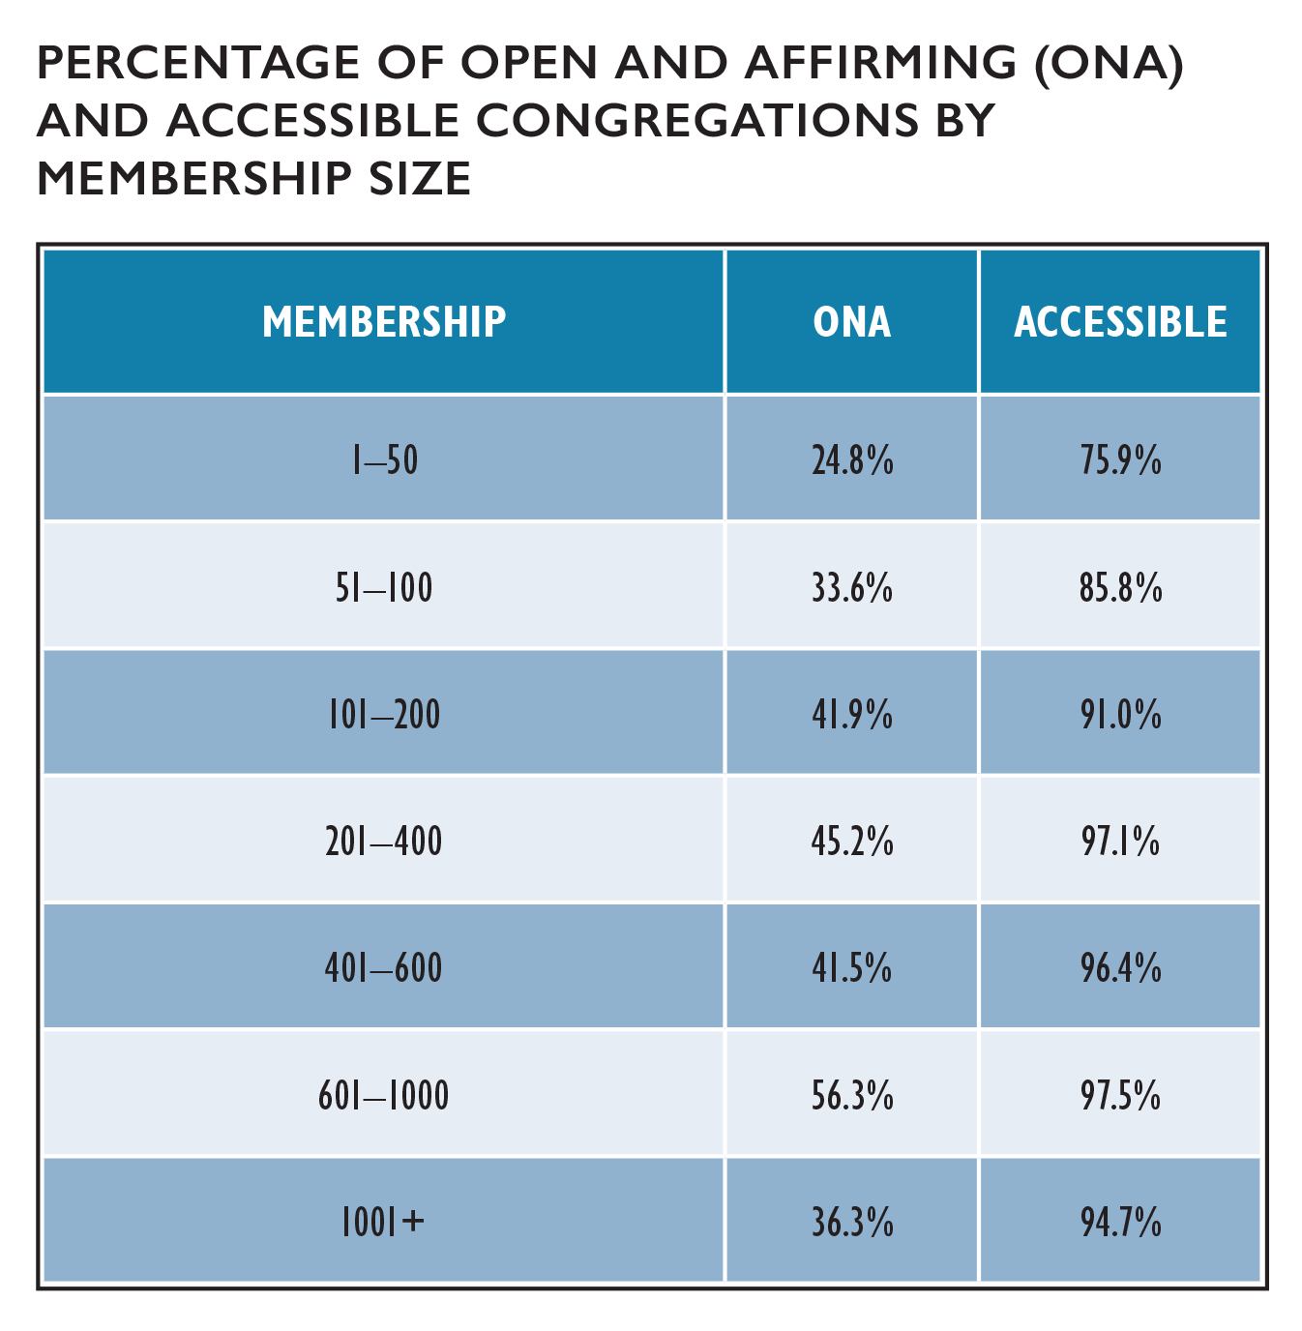
Congregational Designations
Notes:
Since 2005, there has been an 177.5% increase in the number of Open and Affirming (ONA) congregations in the United Church of Christ, from 600 churches in 2005 (10.9% of all UCC churches at that time) to 1,665 churches (36.2% of all UCC congregations in 2022). ONA designations generally tend to be more common as church membership size increases; however, the proportion of churches with 1-50 or 51-100 members continues to grow every year.
Self-reported accessibility also tended to increase with church size. While the specific types and degrees of accessibility among these congregations are unknown, it is possible that these figures partly reflect the resources churches have available to address the accessibility of their space.

Slide 13
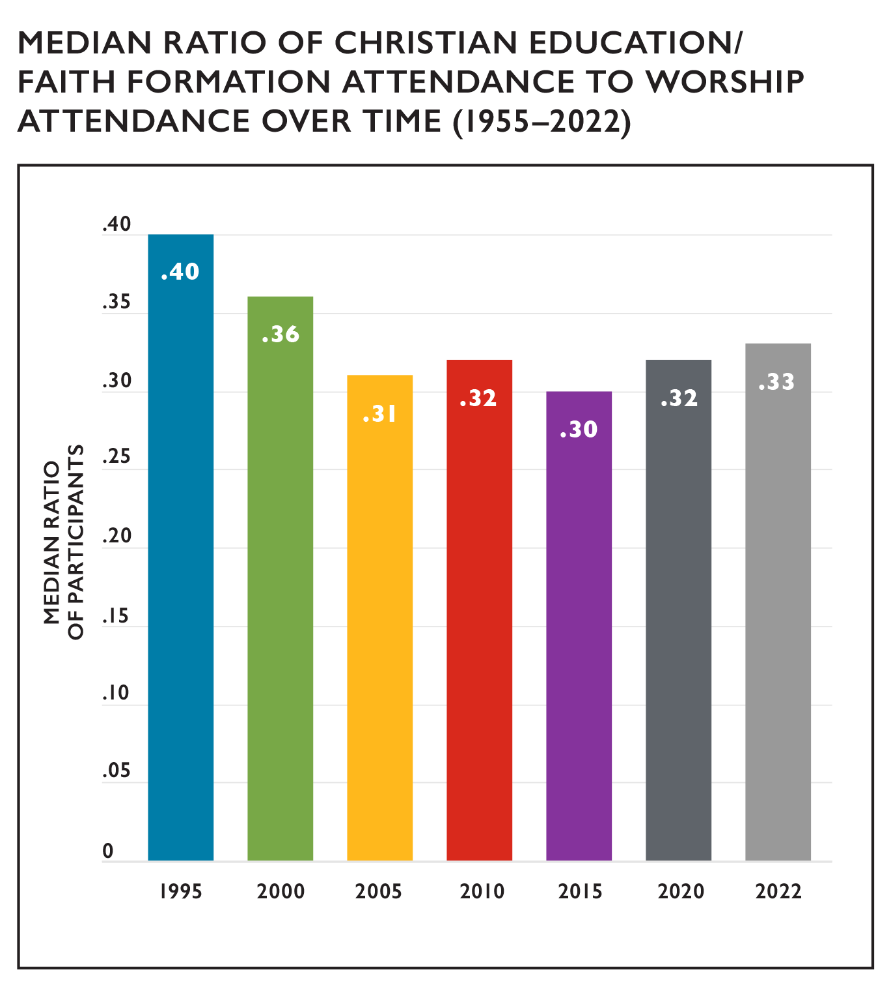
Christian Education/Faith Formation
Notes:
Since the 1950s, enrollment and attendance numbers for Christian Education/Faith Formation programming (also known as Church School or Sunday School enrollment in previous years) has been declining along with membership numbers. When thinking about Christian Education/Faith Formation attendance in terms of all the people who may be present on a Sunday morning (i.e., in comparison to worship attendance), the median percentage of Christian Education/Faith Formation attendance compared to worship attendance has been quite stable since 2005, hovering between 0.30 and 0.32 percent when comparing 5-year increments (the ratio actually increased slightly to 0.33 in 2021 and remained at this level in 2022). This suggests that just under one third of people who attend worship services also attend Christian Education/Faith Formation programming, though these categories may not perfectly overlap in practice. While there had been unusually large decreases in Christian Education/Faith Formation enrollment in 2020 (a net change of –19,903) and 2021 (a net change of –15,668) compared to 2019 (a net change of –7,164)—most likely a result of the pandemic—2022 was much closer to 2019 levels, with a net change of -6,718. In addition, the median ratio of attendance has remained similar to previous years.
In comparing Christian Education/Faith Formation attendance to worship attendance by church size, ratios are fairly similar across church sizes except for churches with 151-200 attendees, which had the lowest ratio (0.29) and churches with 201-400 attendees, which had the highest ratio (0.43).

Slide 14
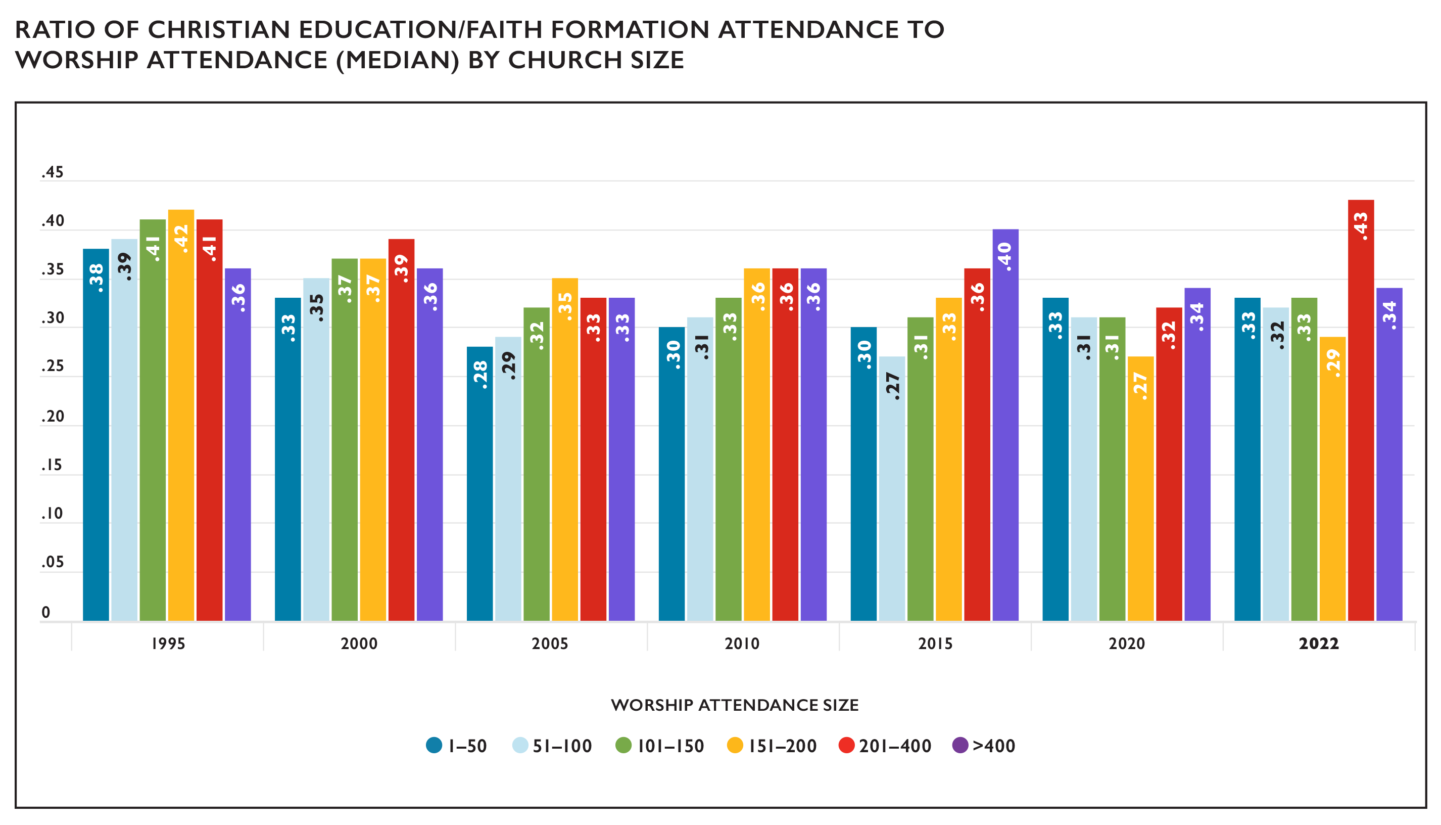
Christian Education/Faith Formation

Slide 15
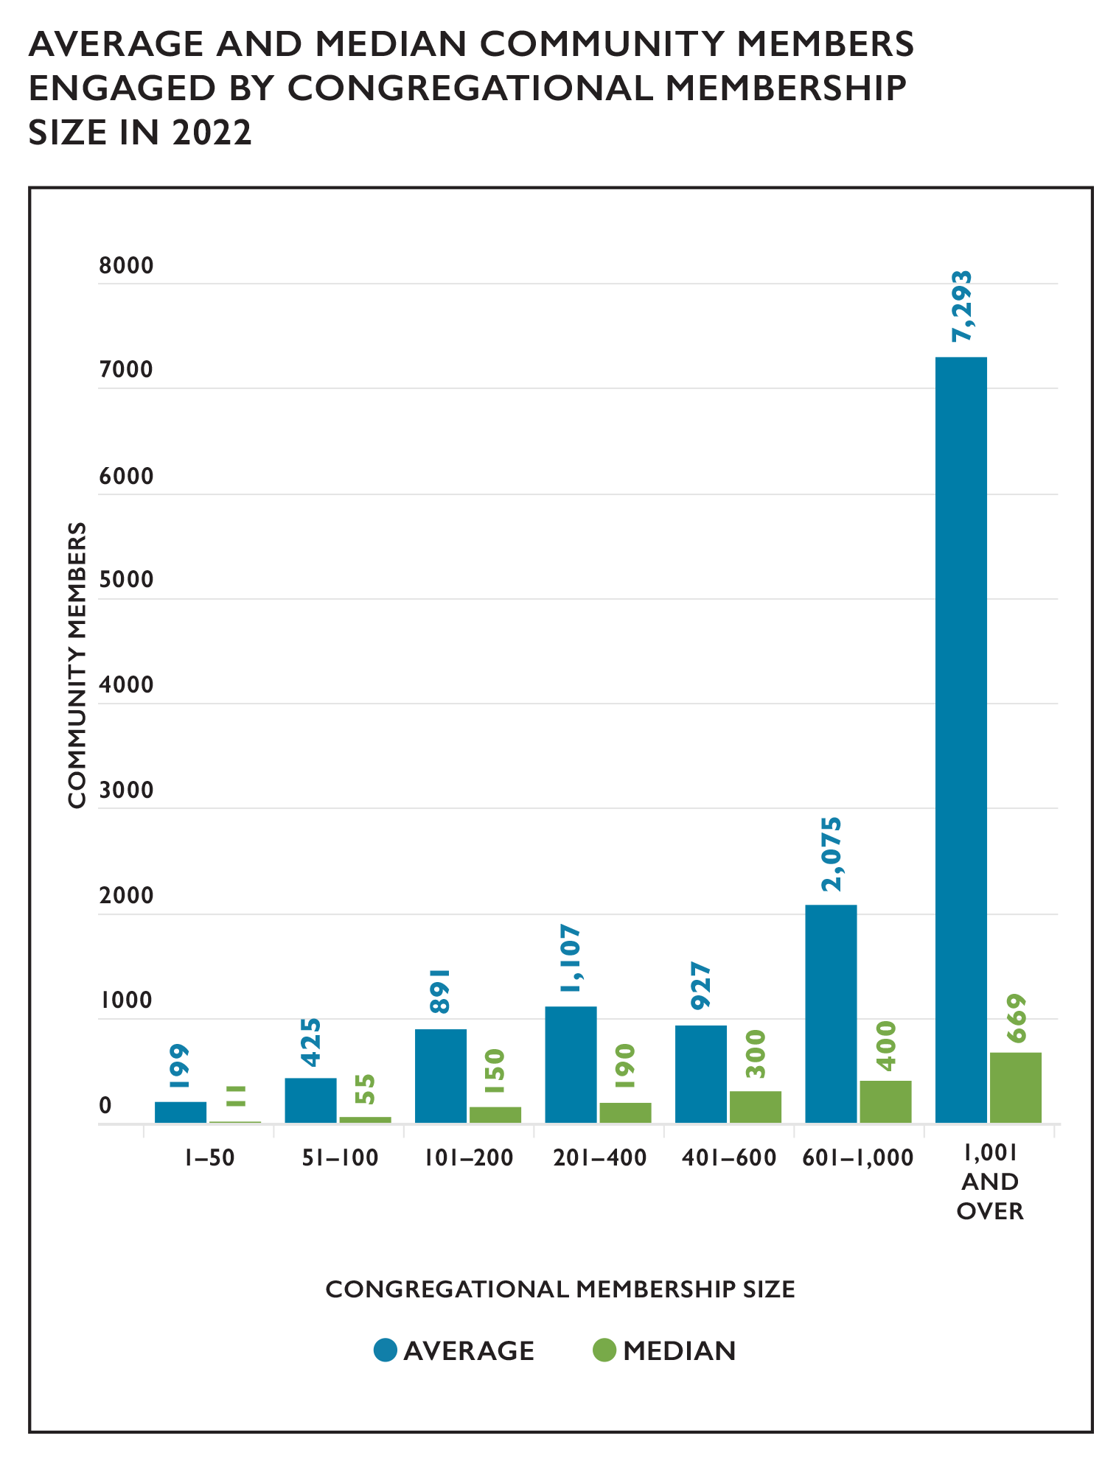
Congregational Outreach
Notes:
Congregational reports indicated that an average of 671 community members and a median of 70 community members were impacted by each local church’s outreach activities and initiatives in 2021. The total number of community members engaged in 2021 was 1,221,322 with 38.5% of congregations reporting. This continues to be lower than the 47.2% of congregations who reported engaging 2,055,868 in 2019 (38.8% of congregations reported engaging 1,211,038 in 2020), which likely reflects the continued impact of the COVID-19 pandemic on congregations’ opportunities to engage with their communities. The average number of community members is notably much higher than the median, which suggests that some churches may have a particular focus on community outreach or may engage in types of outreach that tend to engage more people than other types of outreach.

Slide 16
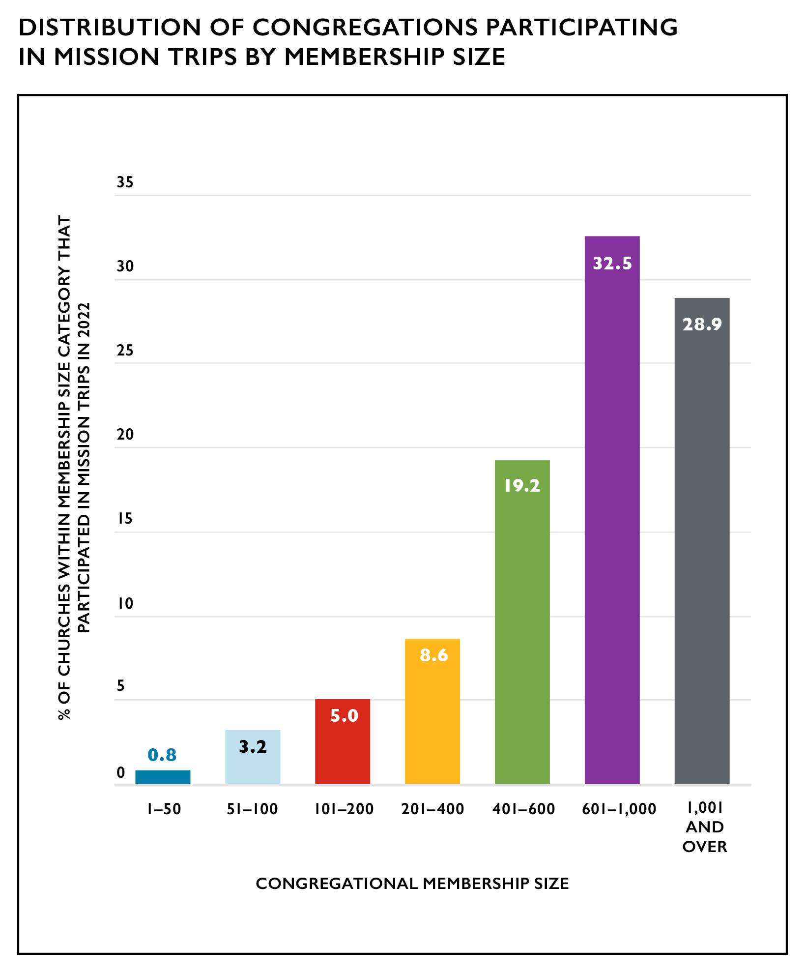
Mission/ Immersion/ Service Trips
Notes:
Since 2014, congregations have been asked to report whether members participated in a U.S. or international mission/immersion/service trip. In 2022, 241 (5.3%) congregations reported that members had participated in these types of trips. This represents an increase over the same figures from 2021 (145 or 3.1% of congregations participating) and 2020 (116 congregations or 2.4% participating) but this remains much lower than the last pre-pandemic figures from 2019, when 574 congregations participated in mission/immersion/service trips. Among churches that did report participating in mission/immersion/service trips in 2022, the largest churches (400+ members) most commonly engaged in this activity, which may reflect the amount of resources increasingly required to engage in such activities, particularly during times of economic uncertainty.

Slide 17
Local Church Financial Trends
Notes:
Average operating expenses for local UCC congregations in 2022 was $185,053, a $8,333 (4.7%) average increase from 2021. Average total income for a local church in 2022 was $246,676, a $10,006 (4.2%) average increase from 2021. The last year an increase was observed in average total income was in 2017. The past several years have all seen a decrease in total income. Over the past decade, both the average operating expenses and income for local congregations increased from average amounts—from $161,271 in expenses (a 14.7% increase) and $211,273 in income (a 44.0% increase) in 2011.
In 2011, Our Church’s Wider Mission (OCWM) giving represented 4.0% of total local church expenditures. This percentage decreased to 3.2% of total local church expenditures in 2022.

Slide 18
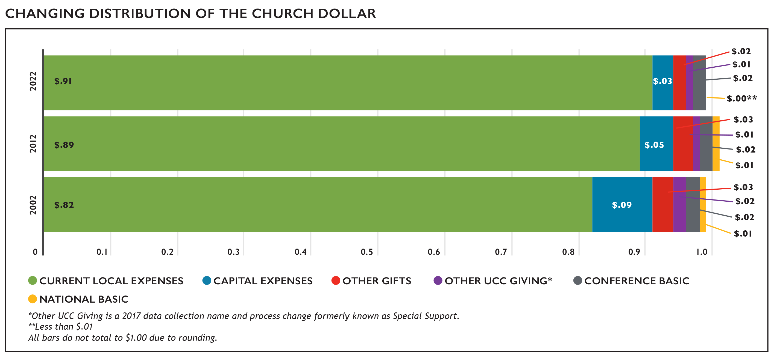
The Church Dollar
Notes:
In the last two decades, the distribution of the church dollar has experienced some noticeable shifts. Current local expenses have increased by $.09 while all others have decreased or remained steady. All types of UCC Giving (Conference Basic, National Basic, and Other UCC Giving) have decreased or remained unchanged in the past 20 years.

Slide 19
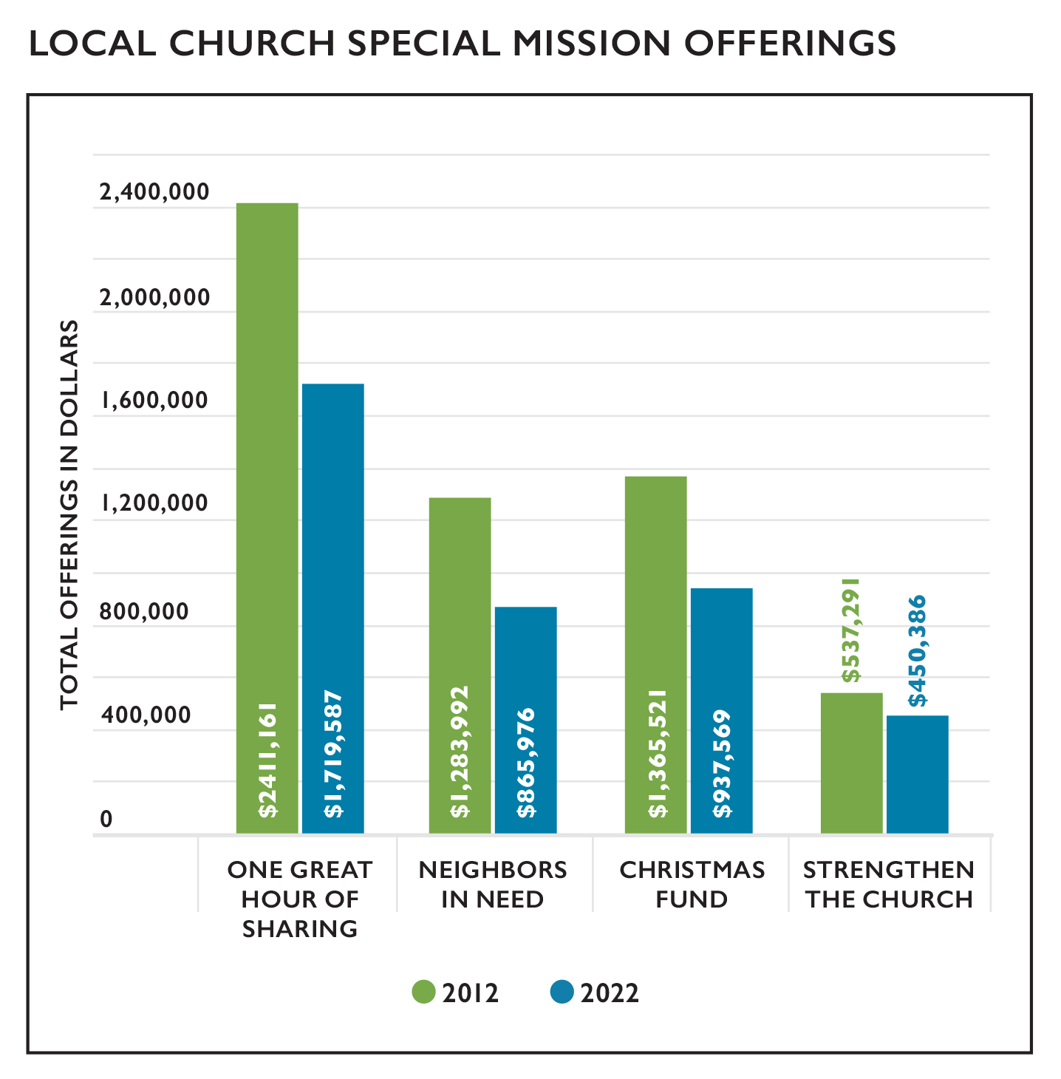
Stewardship and Mission Support
Notes:
Totals for mission support and giving by local congregations of the United Church of Christ decreased over the past several years. Over the past decade, the number of churches that have not given to any Special Mission Offering has continued to increase. This is a trend we have been seeing since 2017.
In terms of dollars given, all the Special Mission Offerings have seen a decrease this year compared to 2012. The total giving to all Special Mission Offerings in 2022 decreased by 29.8% when compared to 2012. This is comparable to the decrease seen from 2011-2021 (31.0%). While these are not as large of a 10-year decrease as seen from 2010–2020 (48.4%), it is still quite larger than seen prior to the COVID-19 pandemic: the decrease from 2009-2019 was 11.7%. The ongoing COVID-19 pandemic may be continuing to contribute to this decline.
Total Mission Support for 2022 increased from the previous year by $3,640,297 (8.2%); this is the first time Total Mission Support giving has increased since 2013. However, it has decreased 12.1% since 2018. The data reported in the 2021 edition of the Statistical Profile indicated larger than usual changes in giving over the previous year. For example, there was a 10.6% decrease in Total Mission Support from 2019 to 2020 while the yearly changes observed in 2018 and 2019 were 5.6% and 6.1%, respectively. The 2022 edition showed giving changes appeared to be returning to levels seen prior to 2020. Other Gifts and Other UCC Giving have both nearly returned to the level seen in 2019.

Slide 20
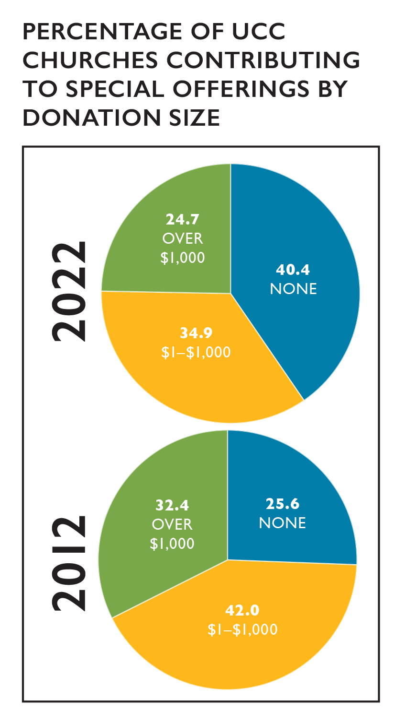
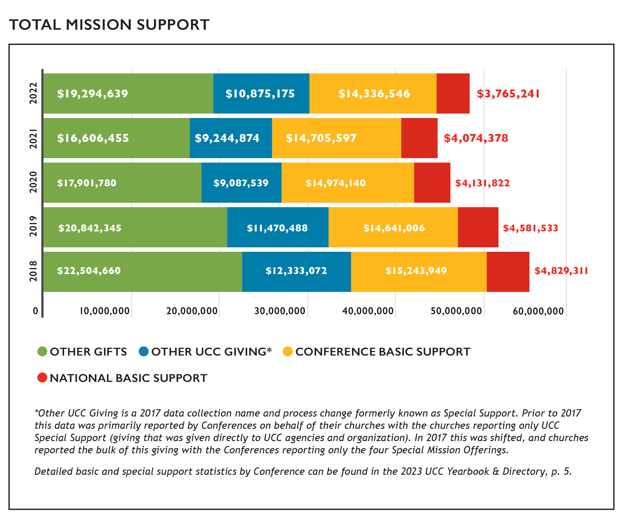
Stewardship and Mission Support

Slide 21
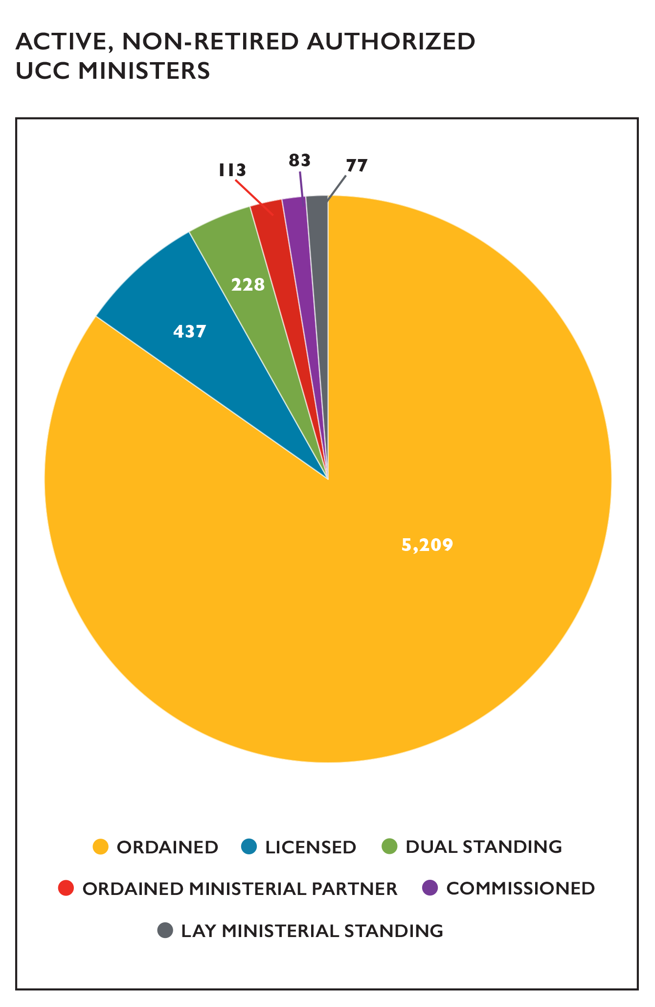
Summary of UCC Ordained Ministers
Notes:
As reported for 2022, there were a total of 6,147 active, non-retired Authorized Ministers in the United Church of Christ (Ordained, Licensed, Lay Ministerial Standing, Dual Standing, and Ordained Ministerial Partner). Ordained Ministers were the largest percentage of active ministers reported (84.7%); and Licensed Ministers comprised the second largest group of Authorized Ministers (7.1%). In addition, two active, non-retired ministers hold standing in the Congregational Christian Church.

Slide 22
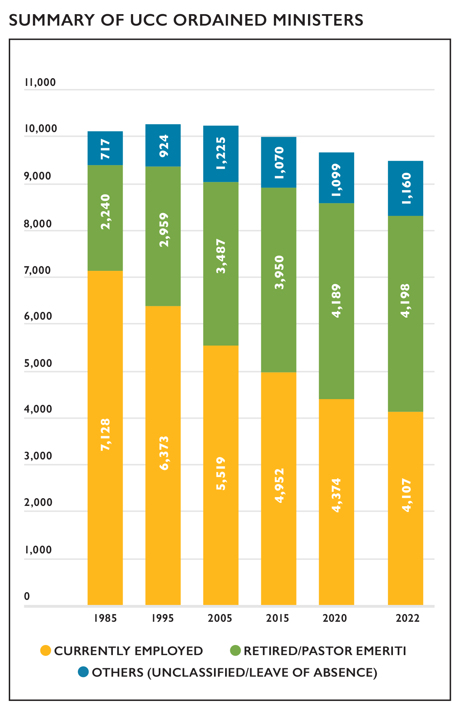
Summary of UCC Ordained Ministers
Notes:
At the end of 2022, there were 9,465 reported Ordained Ministers in Full Standing, including Retired Ministers and Pastor Emeriti. Of those 9,465 Ordained Ministers, nearly one-half (43.4% or 4,107) were employed, with 68.4% (2,808) of those employed actively serving in a local church (either a UCC church or non-UCC church). Four out of ten (44.4% or 4,198) were Retired Ministers or Pastor Emeriti, and 12.3% (1,160) were unclassified (ministers without a reported specialty at the time of Yearbook production) or were on a leave of absence.
Over the last 37 years (1985 to 2022), Ordained Ministers only had a numerical net decrease of 620 (6.1%). However, the number of employed Ordained Ministers decreased by over one third (42.4%), while Retired Ministers and Pastor Emeriti saw an increase of 87.4% over this same 37-year period.

Slide 23
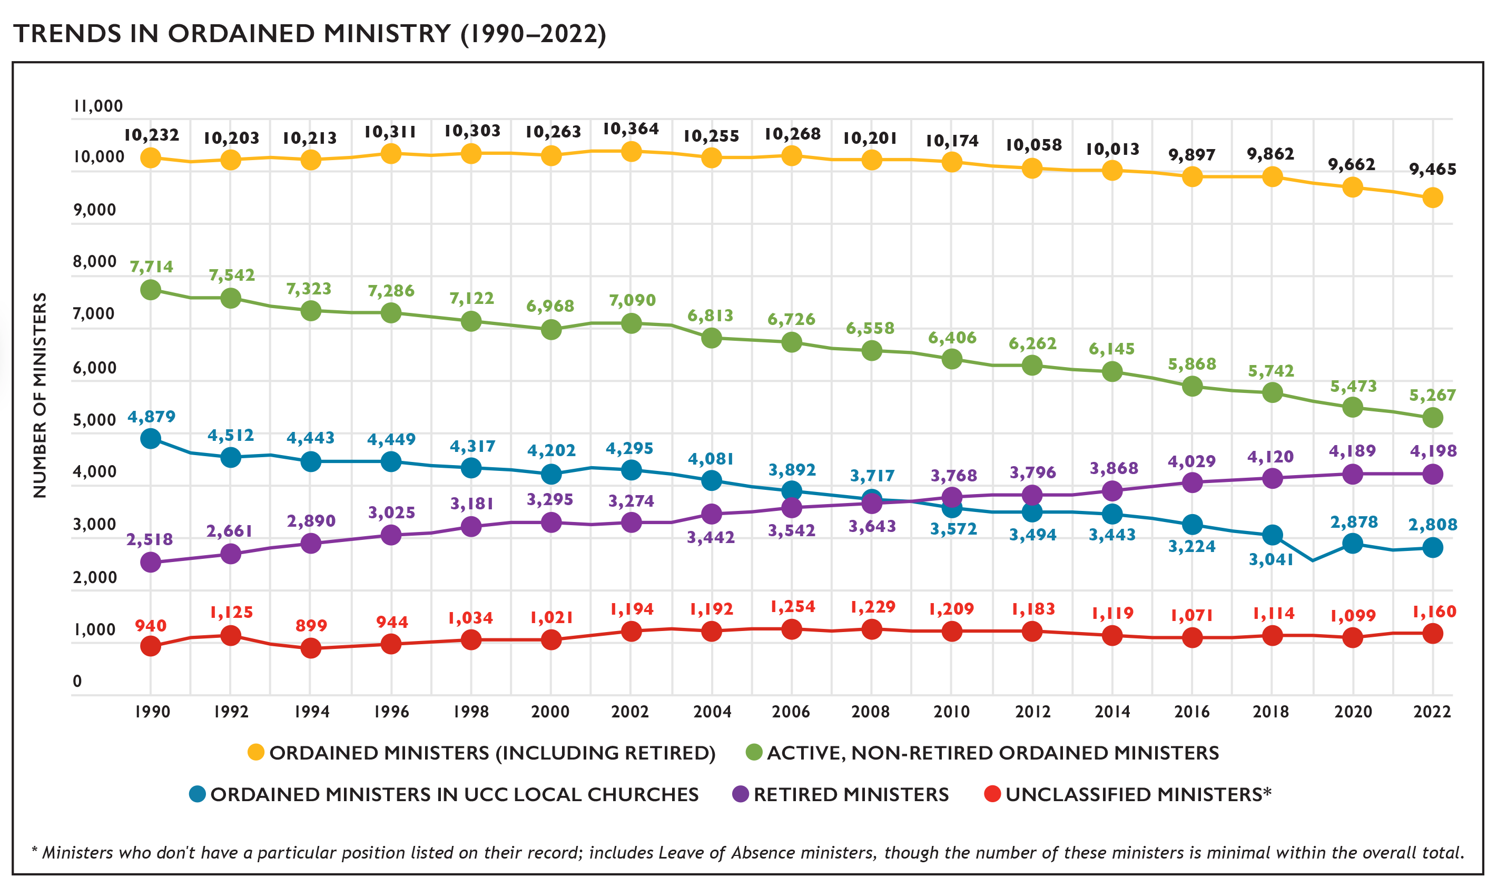
Trends in Ordained Ministry
Notes:
Since 1990, the number of Ordained Ministers has remained relatively stable, though there are slight incremental decreases in more recent years. At the same time, the number of Retired Ministers and Pastor Emeriti has increased steadily. Notably, since 1990 the decline in ordained ministers (7.5%) has been much smaller than the declines in congregations (27.3%) or membership (55.6%) during the same time frame.

Slide 24
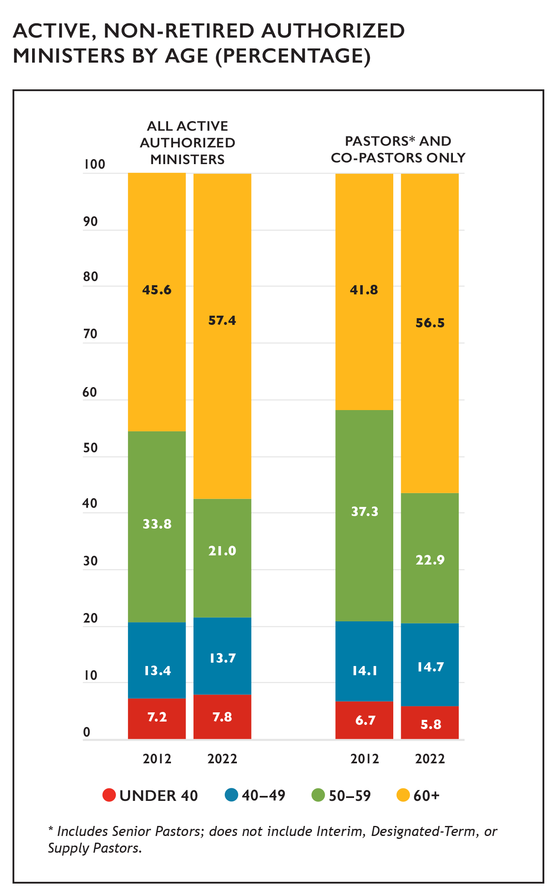
Authorized Ministers by Age
Notes:
Data regarding Authorized Ministers in the denomination reflects a population of predominantly older clergy. Over one half of all active, non-retired Authorized Ministers were age 60 and above (57.4%) and over three-quarters (78.4%) were 50 and older. Local Church Pastors and Co-Pastors are increasingly comprised of the oldest clergy in the UCC, with over half (56.5%) of all congregations in 2022 being served by Authorized Ministers aged 60 and above while only 41.8% were served by this group in 2012. The number of congregations being served by clergy under 50 has remained relatively stable.

Slide 25
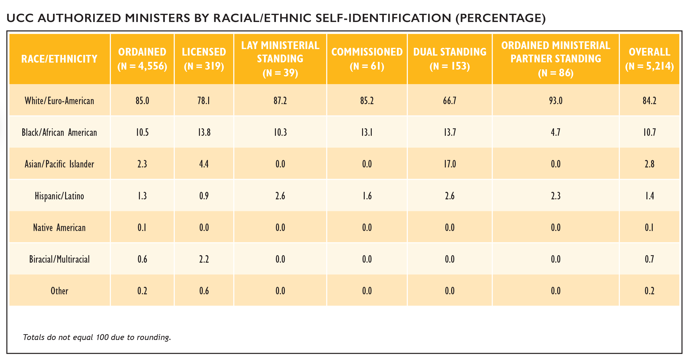
Authorized Ministers by Race/Ethnicity
Notes:
The majority (84.2%) of all active, non-retired UCC Authorized Ministers identified as White/Euro-American, with 15.8% identifying as nonwhite. Among the various types of authorization, Ministers with Dual Standing continue to be the most racially/ethnically diverse group with three in ten (33.3%) ministers identifying as non-white. Ministers with Ordained Ministerial Partner Standing were the least racially/ethnically diverse authorization groups, with only 7.0% identifying as non-white.

Slide 26
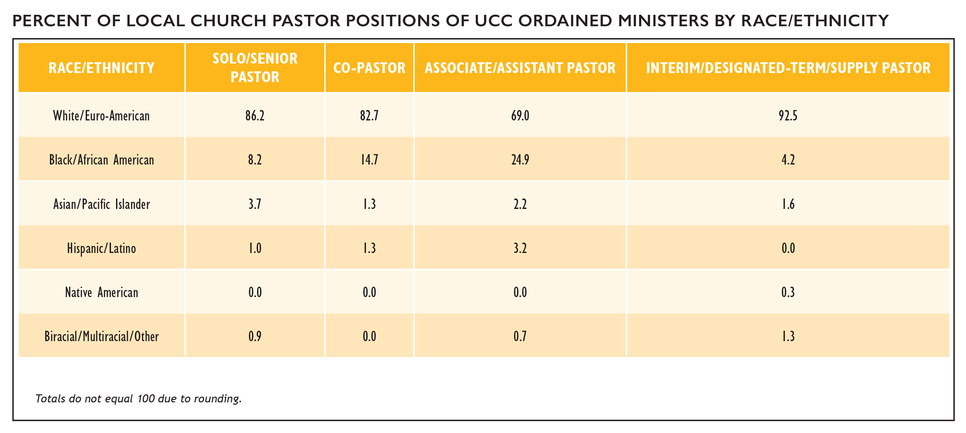
Ordained Ministers in Local Churches by Race/Ethnicity
Notes:
Regarding racial/ethnic representation in local church pastor positions, different patterns emerge based on position. Among Senior/Solo Pastors, clergy who identify as Black/African American were proportionally under-represented (8.2% compared to 10.5% of all clergy) while clergy who identify as White/Euro-American were represented at a slightly higher rate among Senior/Solo Pastors (86.2%) compared to clergy overall (85.0%). Associate/Assistant Pastors were notably more racially/ethnically diverse compared to clergy overall, with 31.0% of clergy self-identifying as non-white compared to 15.0% of all active, non-retired Authorized Ministers.

Slide 27
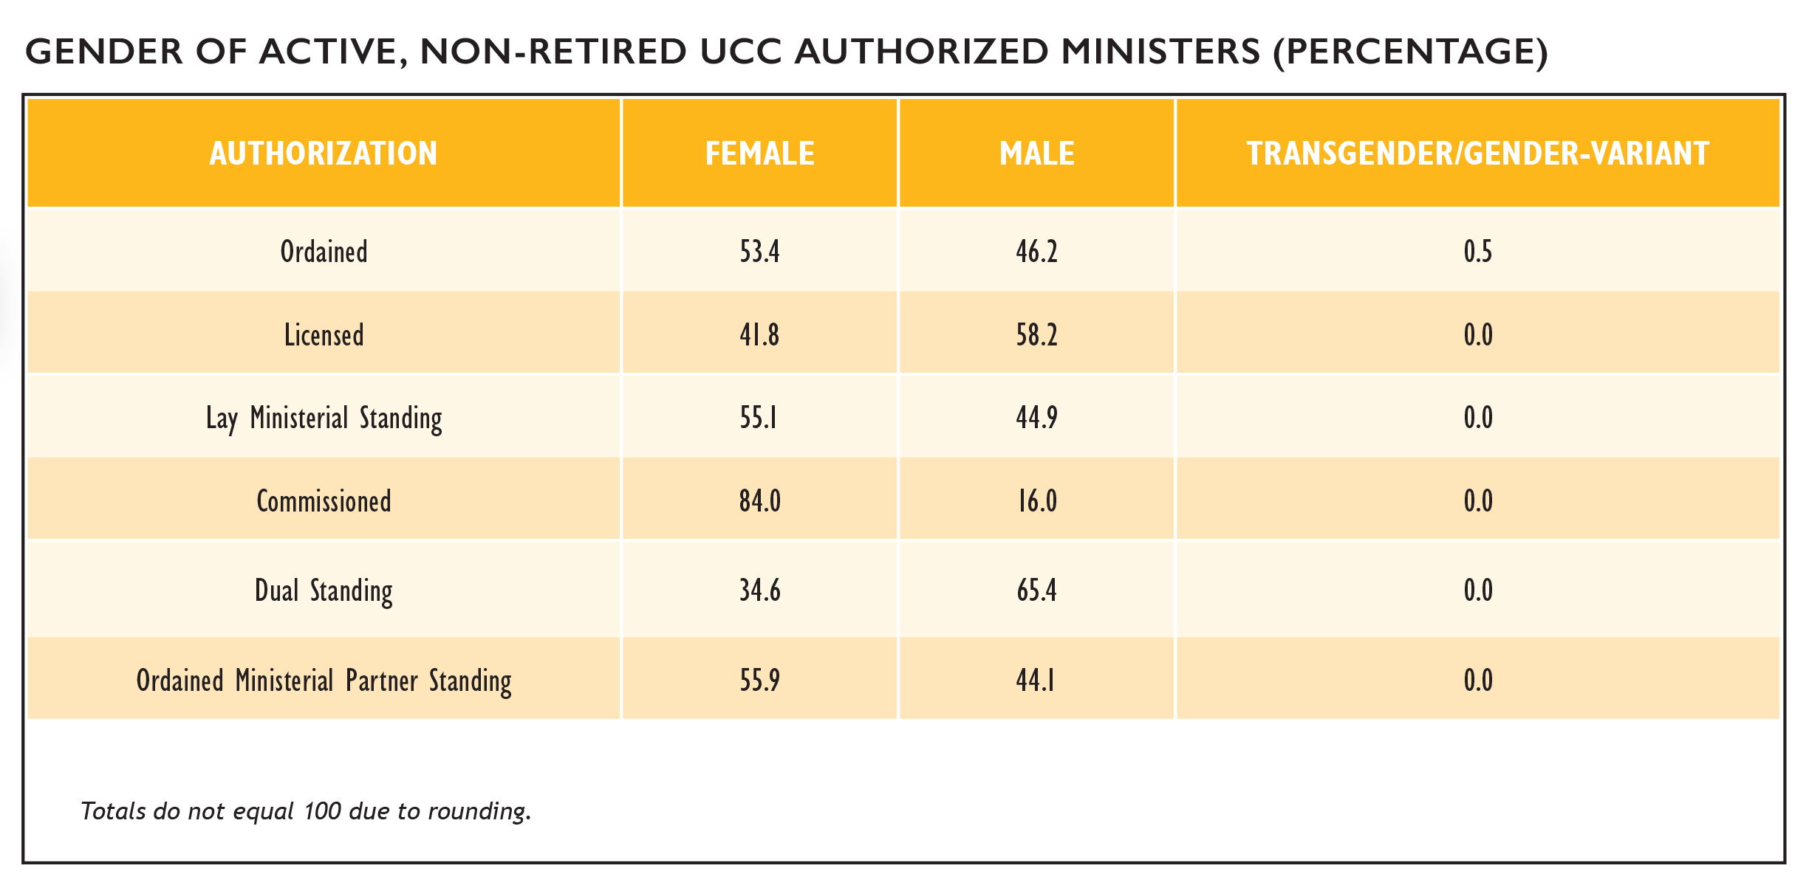
Authorized Ministers by Gender
Notes:
In total, 53.4% of active, non-retired Ordained Ministers in the United Church of Christ identified as female, 46.2% identified as male, and 0.5% identified as transgender/gender-variant. This is a notable shift from the early 2000s, when according to the 2003 UCC Statistical Handbook only 27% of all Ordained Ministers identified as female. Among other categories of Authorized Ministers, Licensed and Dual Standing Ministers proportionately identified more often as male, while more than 4 out of every 5 Commissioned Ministers identified as female.

Slide 28
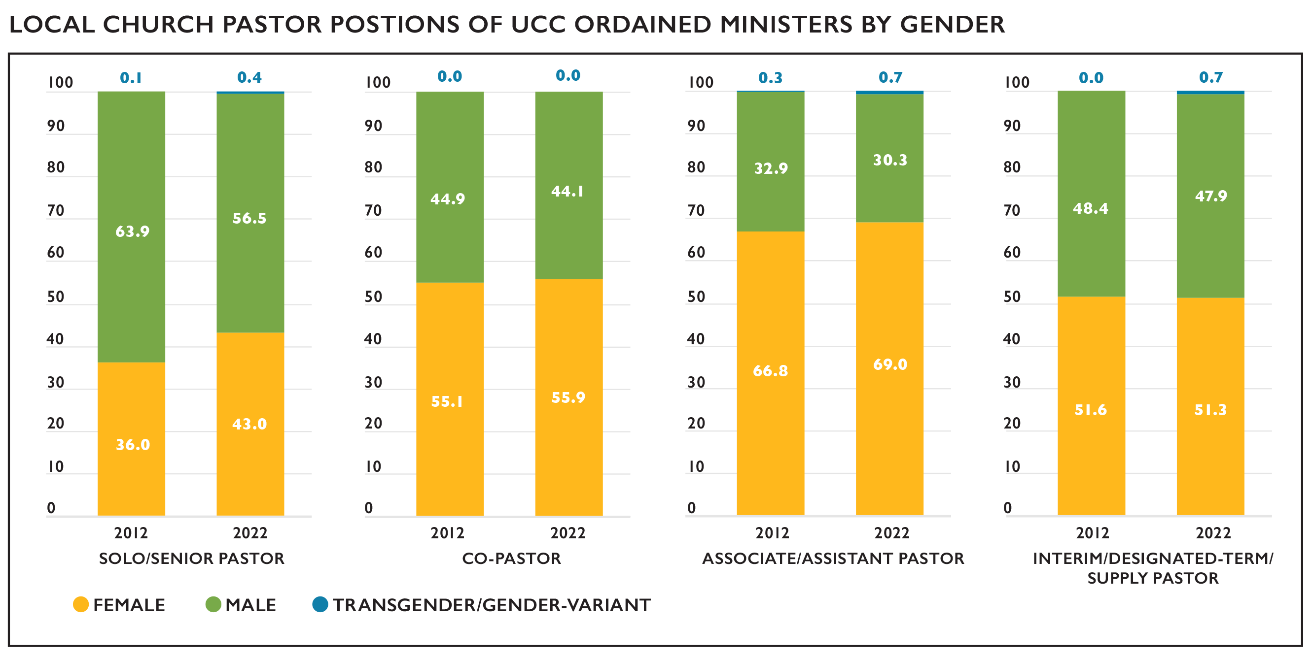
Ordained Ministers in Local Churches by Gender
Notes:
The percentage of active, non-retired female Ordained Ministers serving in local UCC church pastoral positions has continued to increase over the past several years. The rate at which females are serving in local church pastoral positions is increasing at a higher rate for Senior/Solo Pastors than any other local church position. The earliest UCC Statistical Handbook from 2000 indicates only 21.9% of Senior/Solo Pastors were female, by 2012 this percentage had increased to 36.0%. Our most recent data indicates females are now serving as Senior/Solo Pastors at a rate of more than four in ten (43.0%).

Slide 29
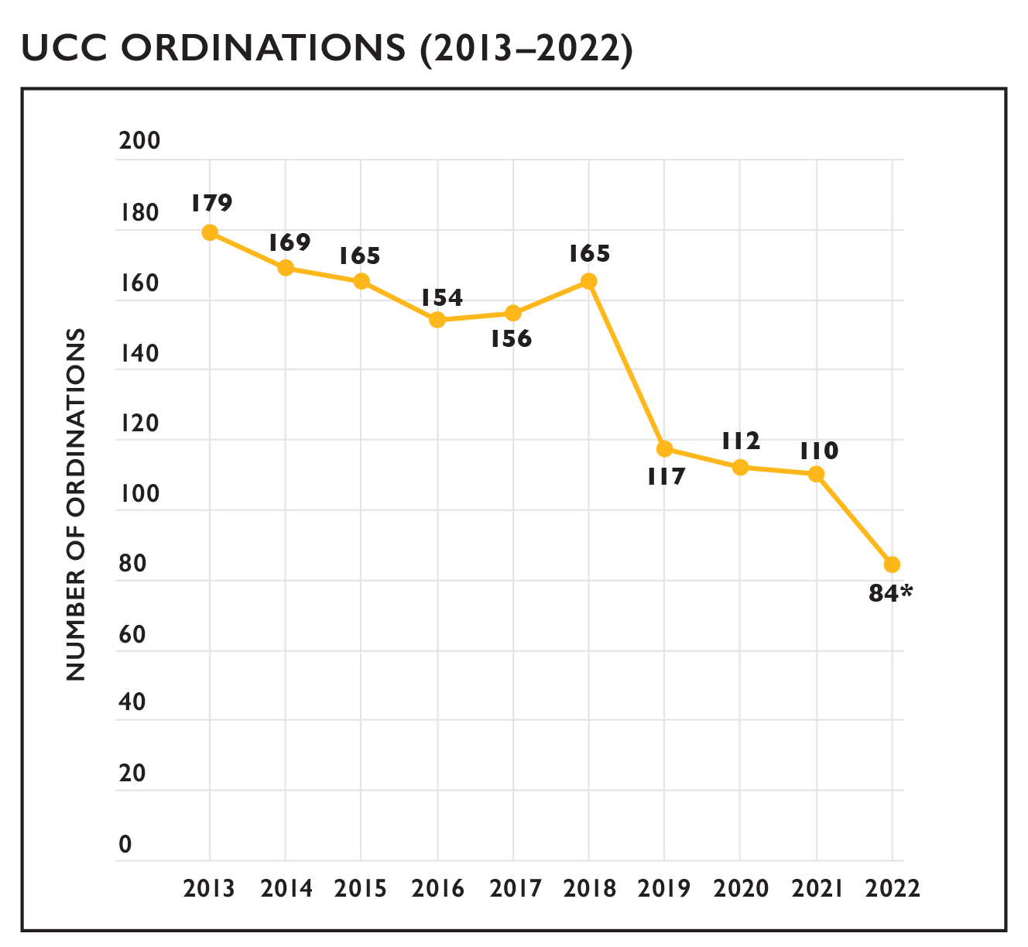
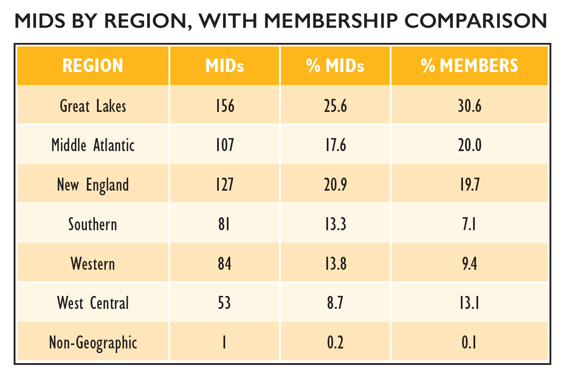
Ordinations and Members in Discernment
Notes:
The number of ordinations per year decreased over the past decade. Overall, the number of ordinations has been in decline except for 2018 when there was a notable increase in ordinations over the previous year. When reviewing trends over the past several decades, however, ordination numbers fluctuated in similar ways; there is a distinctive downward trend; however, there are years when numbers increased more than 5% and began the downward trend again.
As of May 2023, there were 609 active Members in Discernment (MIDs) on record within the denominational database. Some regions—Southern and Western—had proportionally more MIDs compared to their overall membership proportion in the UCC.
Among MIDs who report their gender identity, females comprised 57.4% of all MIDs, a greater percentage than that of current female Authorized Ministers, which currently comprise 53.4% of all non-retired Ordained clergy. It is important to note that one-third (34.8%) of all MIDs do not have a gender recorded. Members in Discernment were also more racially/ethnically diverse than current Ordained Ministers with 29.7% identifying as non-white (compared with 15.0% of all Ordained Ministers identifying as nonwhite).
*Number of ordinations for 2022 and recent previous years is expected to increase in 2023 as additional records are updated by Conferences.

Slide 30
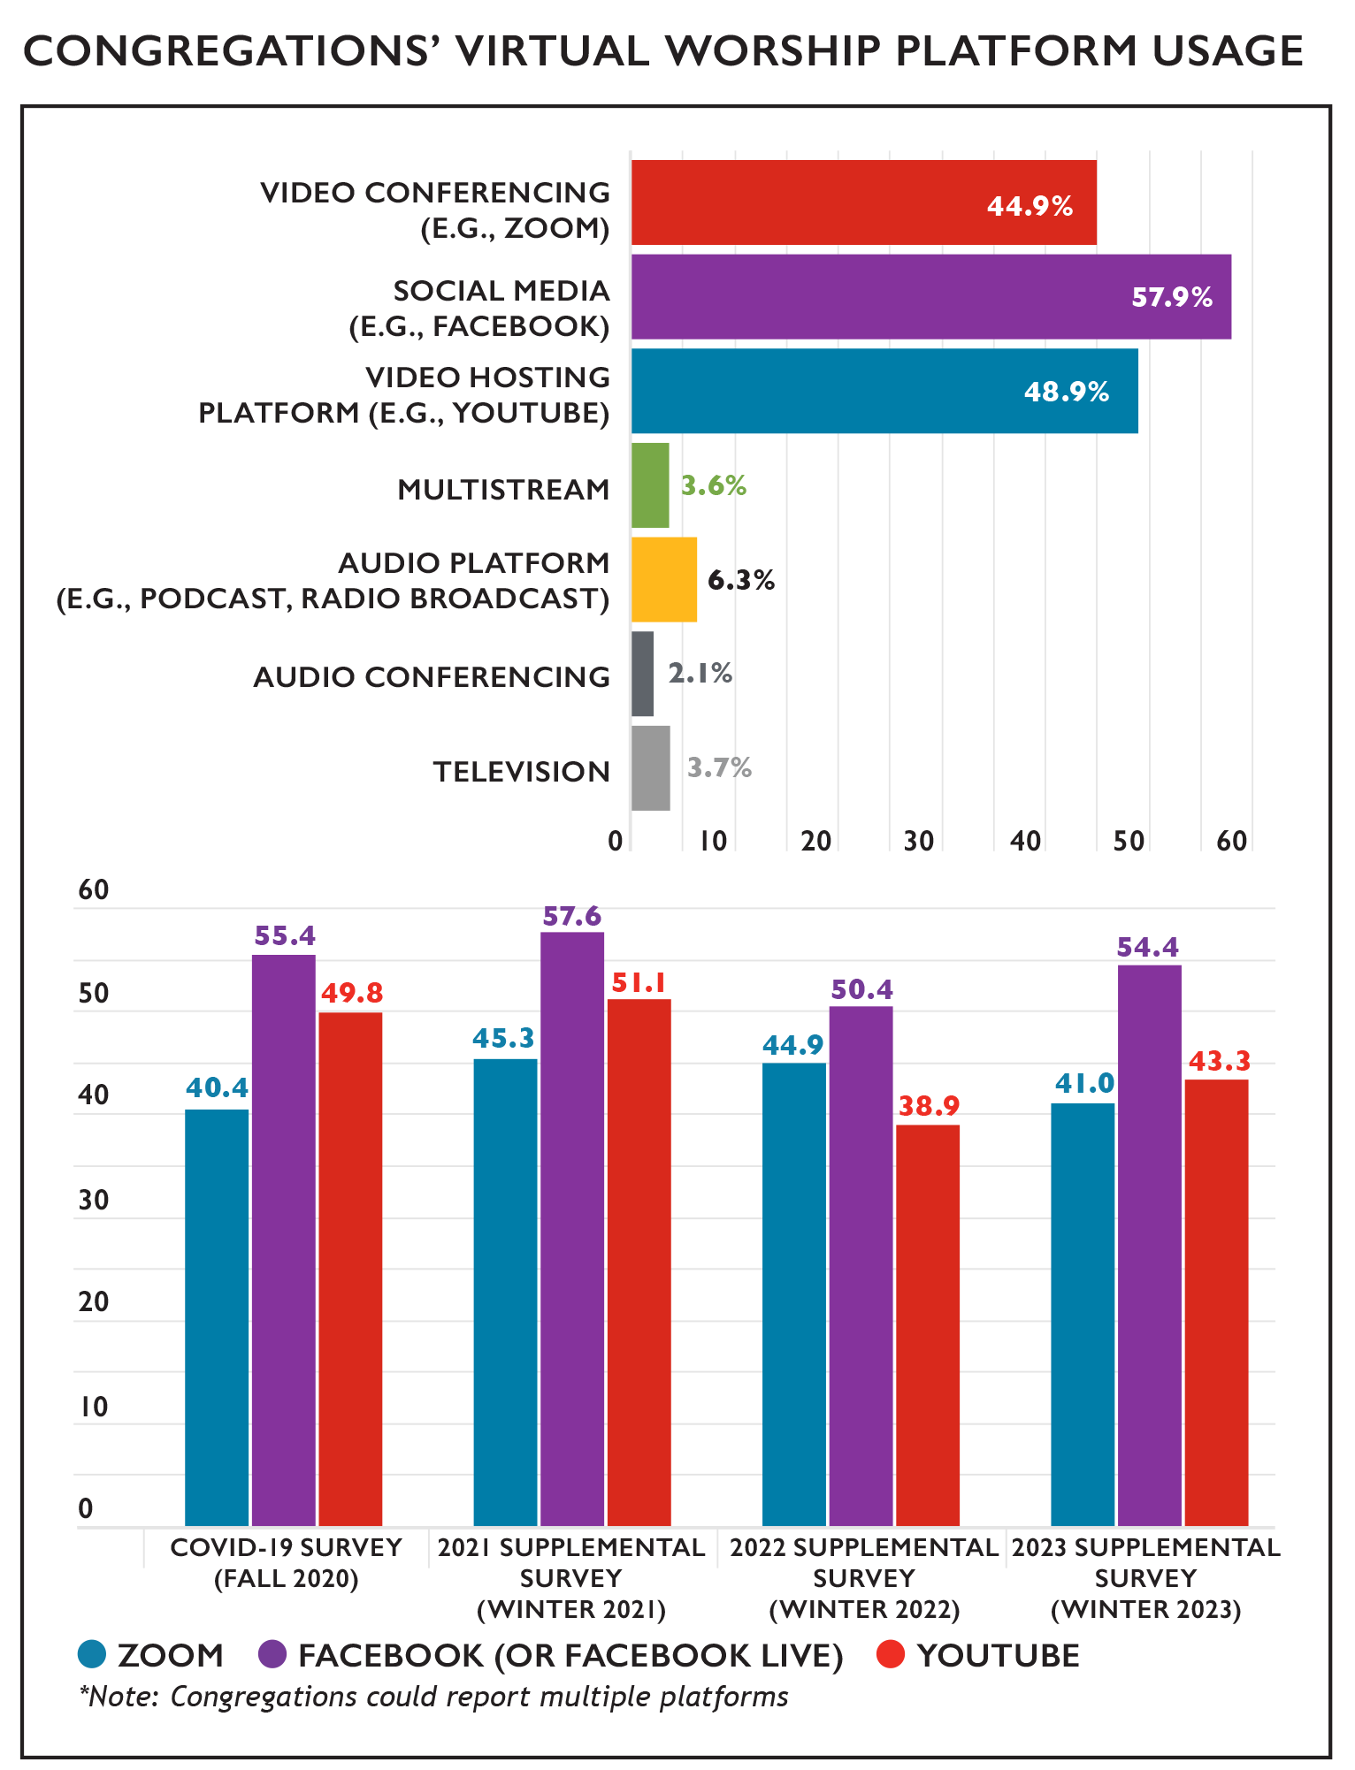
Virtual Worship Platform Usage
Notes:
One of the most notable changes brought to congregational life by the COVID-19 pandemic was the expansion and ongoing offering of virtual worship. In a survey conducted during the fall of 2020, only 9% of congregations reported offering virtual worship prior to the pandemic; by the winter of 2021, however, 91.3% of congregations reported offering virtual worship at some point during the pandemic. Recognizing that virtual worship has quickly become a regular feature of church life, this question was rephrased in the 2022 Supplemental Survey to ask congregations if they held virtual worship at any time in the year prior. In 2023, 80.8% of congregations responded “yes.” Among congregations who reported holding virtual worship opportunities, more than 9 out of 10 (91.1%) reported offering these opportunities every week, with an additional 4.2% reporting such opportunities were offered more than once per week.
80.7% of congregations holding virtual worship reported streaming their in-person worship service. Zoom, Facebook/Facebook Live, and YouTube were the most commonly used individual platforms reported in 2022, though small numbers of churches used a wide variety of platforms to share their worship services. Even as congregations resume in-person worship, virtual worship is likely to remain a common offering alongside in-person worship, as 96.2% of congregations that held virtual worship in 2022 reported that they are planning to continue to offer virtual worship in the future.

Slide 31
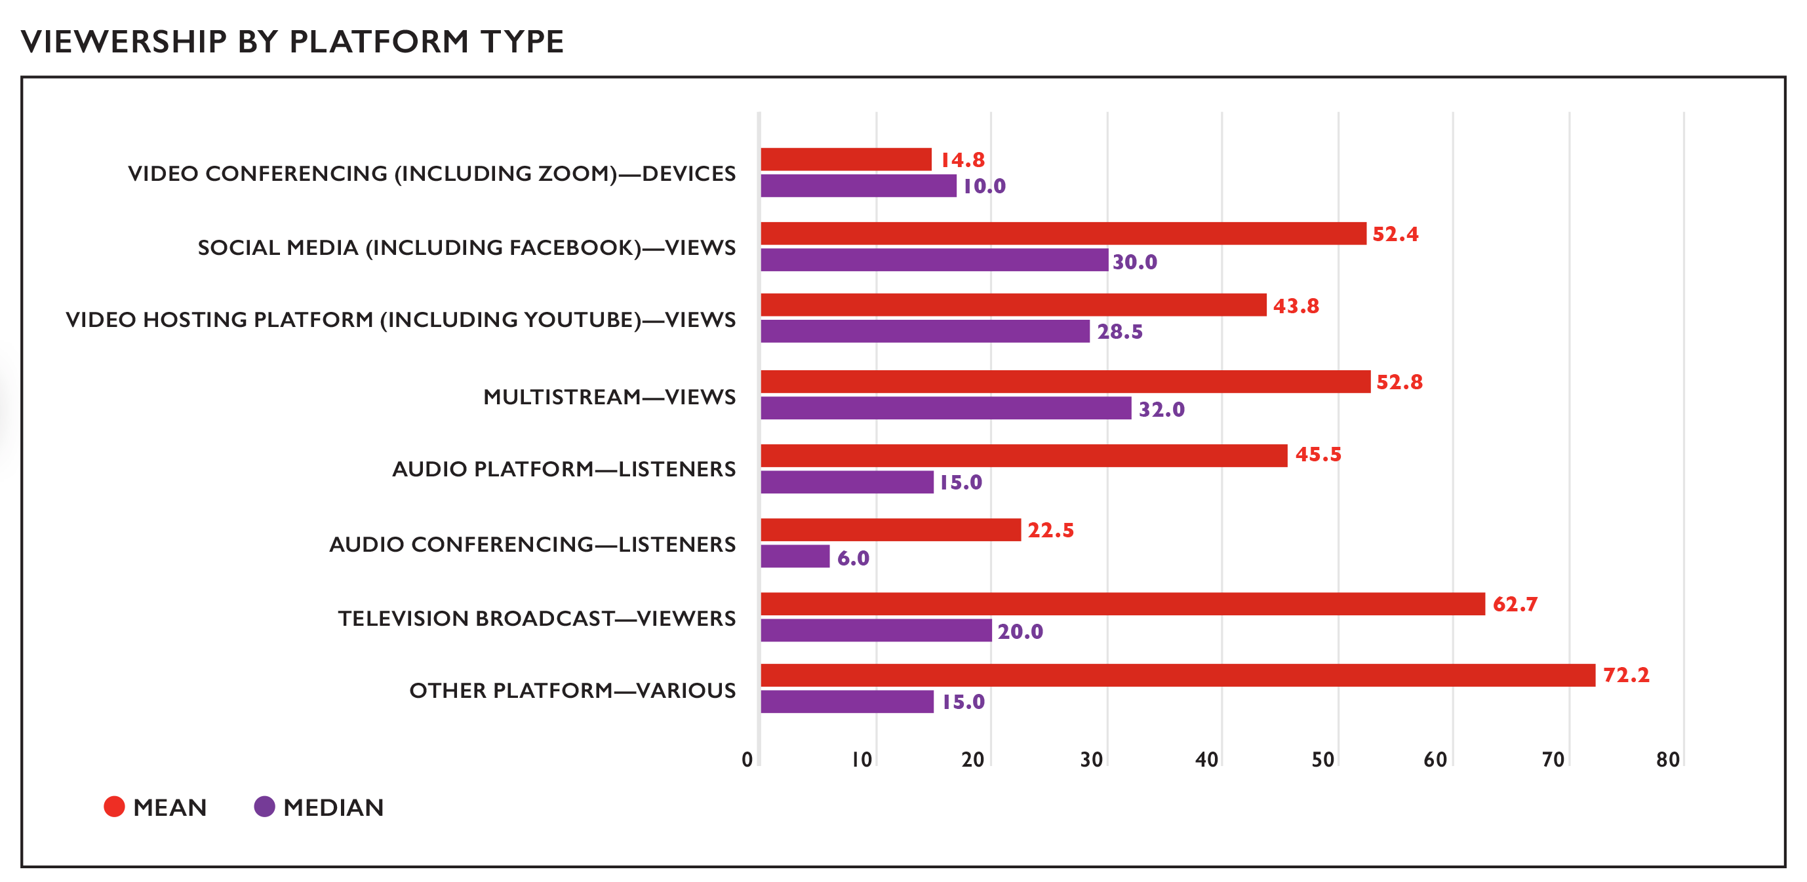
Viewership Across Virtual Platforms
Notes:
Virtual worship attendance is measured separately from in-person worship attendance because these numbers essentially measure different things. While in-person worship attendance figures represent the number of people present, online worship attendance generally represents the number of devices that have connected, as multiple people may be viewing worship on a single device, or a single device may connect multiple times. In addition, different platforms have different ways of measuring viewership, which is why attendance is measured separately for different platforms.
Given that virtual worship will continue to be a part of church life for the majority of UCC congregations, CARDD will continue to collect this data going forward. While currently the Data Hub is not equipped to collect this data, once CARDD has determined the most reliable way to capture virtual worship attendance for the future, this data will be directly reportable into the Data Hub along with the rest of a church’s annual data. In the meantime, this data is being recorded in the annual Supplemental Survey, where it is attached to church ID so it can be part of a church’s long-term records.

Slide 32
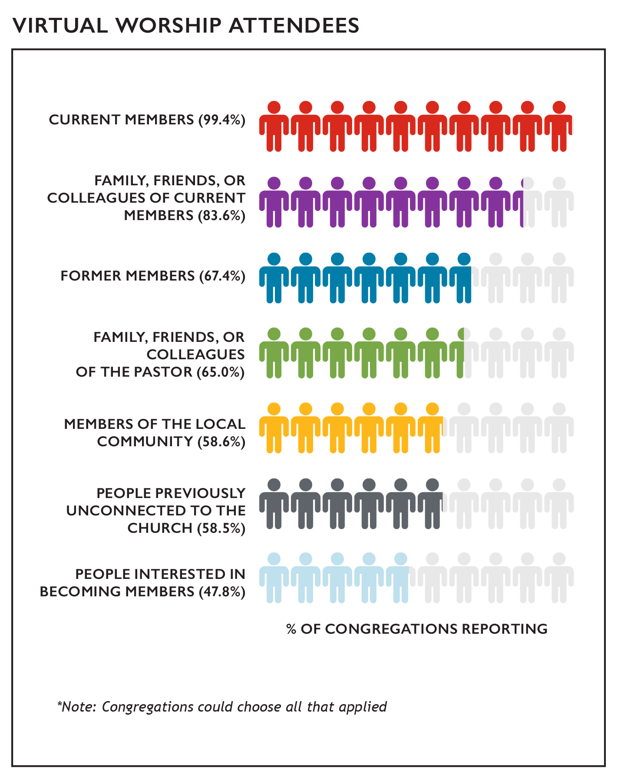
Composition of Virtual Worship Attendance
Notes:
Virtual worship has enabled congregations to welcome new people to their church as well as reconnect with people whom they haven’t seen in a while. Among churches holding virtual worship, nearly all congregations (99.4%) reported that current members attended their services. In addition, family, friends, and colleagues of current members (83.6%) as well as family, friends, and colleagues of the pastor (65.0%) also commonly attended congregations’ online worship services. Over half of congregations (58.5%) reported that people previously unconnected to their church were attending their online worship services and 47.8% of congregations reported that people interested in becoming members were attending online worship services, suggesting that virtual worship may be a way many congregations can and are engaging in outreach.

Slide 33
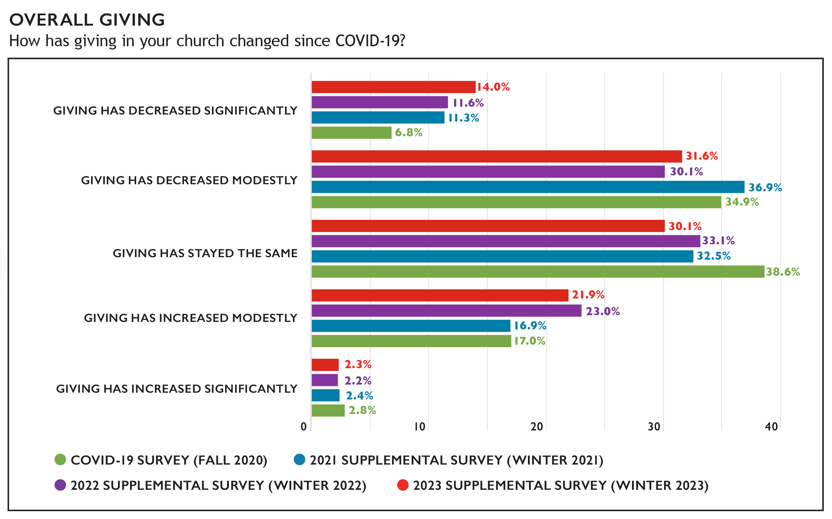
Giving Since the Pandemic
Notes:
The pandemic has had a variety of financial implications for congregations and these implications have continued to shift over time. Since the 2022 Supplemental Survey, the proportion of congregations that have reported their giving has decreased significantly was higher (increasing from 11.6% to 14.0%), as was the proportion of congregations reporting that their giving decreased modestly (increasing from 30.1% to 31.6%). Taken together, the proportion of congregations reporting that their giving has decreased since the pandemic began is higher (45.7%) than in 2022 (41.7%) but remains lower than it was in 2021 (48.2%). The proportion of congregations reporting that giving has stayed the same decreased slightly (30.1% in 2022 from 33.1%), while roughly a quarter (24.2%) of congregations reported in 2022 that their giving has actually increased modestly or significantly during the pandemic (down from 25.2% in 2021). These trends have changed directions a few times between the first COVID-19 survey in 2020 and present supplemental survey, suggesting the impact of the pandemic and changing economic conditions on congregations’ finances is dynamic and experiences have varied widely among churches.

Slide 34
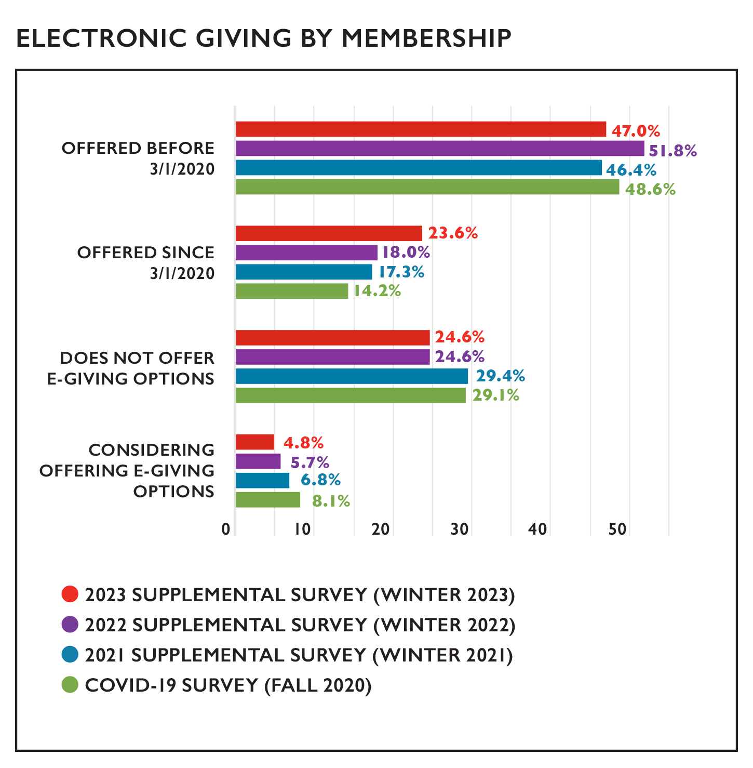
Initiation of E-Giving
Notes:
As congregations have expanded virtual worship opportunities, electronic giving has been a way for people to contribute financially to congregations without being physically present. Around half of congregations (47.0%) reported offering electronic giving options before the pandemic, and now more than seven in ten congregations (70.6%) offer electronic giving. This proportion has not changed much since the initial COVID-19 survey in the fall of 2020 but has slightly increased over time, suggesting that churches that adopted online giving as a result of the pandemic did so early on. Churches most frequently reported using Vanco/Realm, PayPal, and the church website for electronic giving; other options reported being used include Tithe.ly, Venmo, Breeze, or payments directed by givers from individual banks.

Slide 35
Special Reports Denominational Trends: Members, Clergy, and Congregations

Slide 37
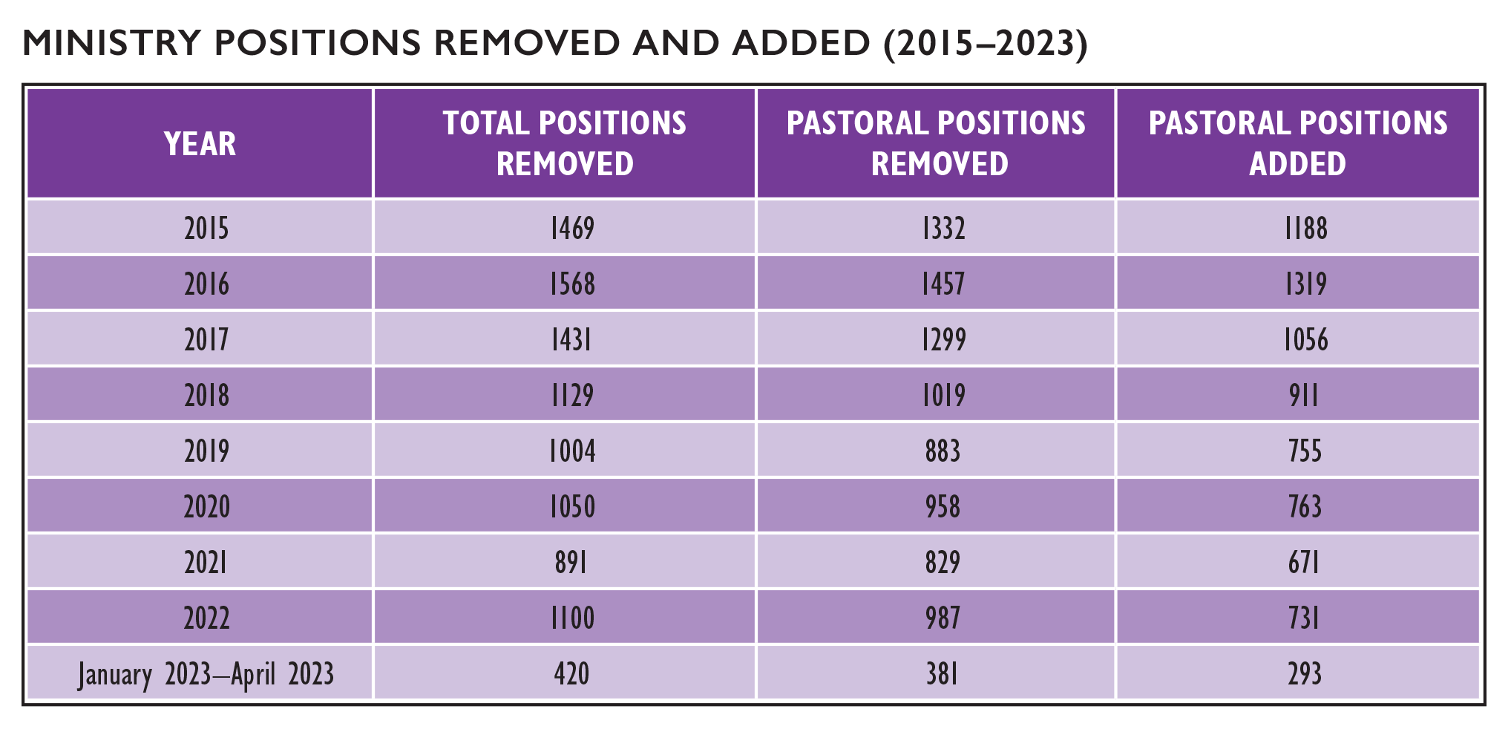
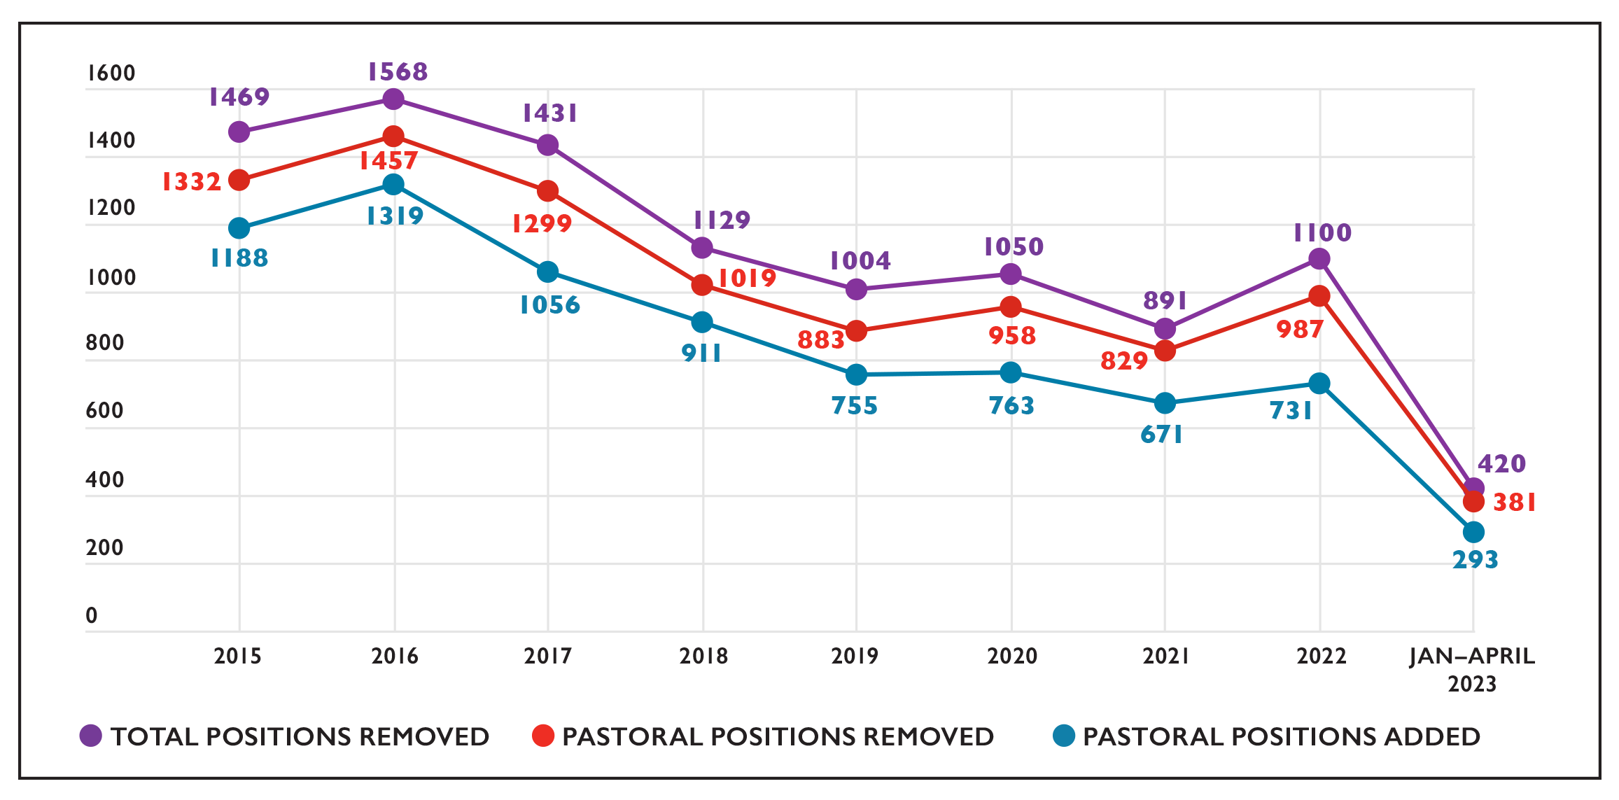

Slide 38
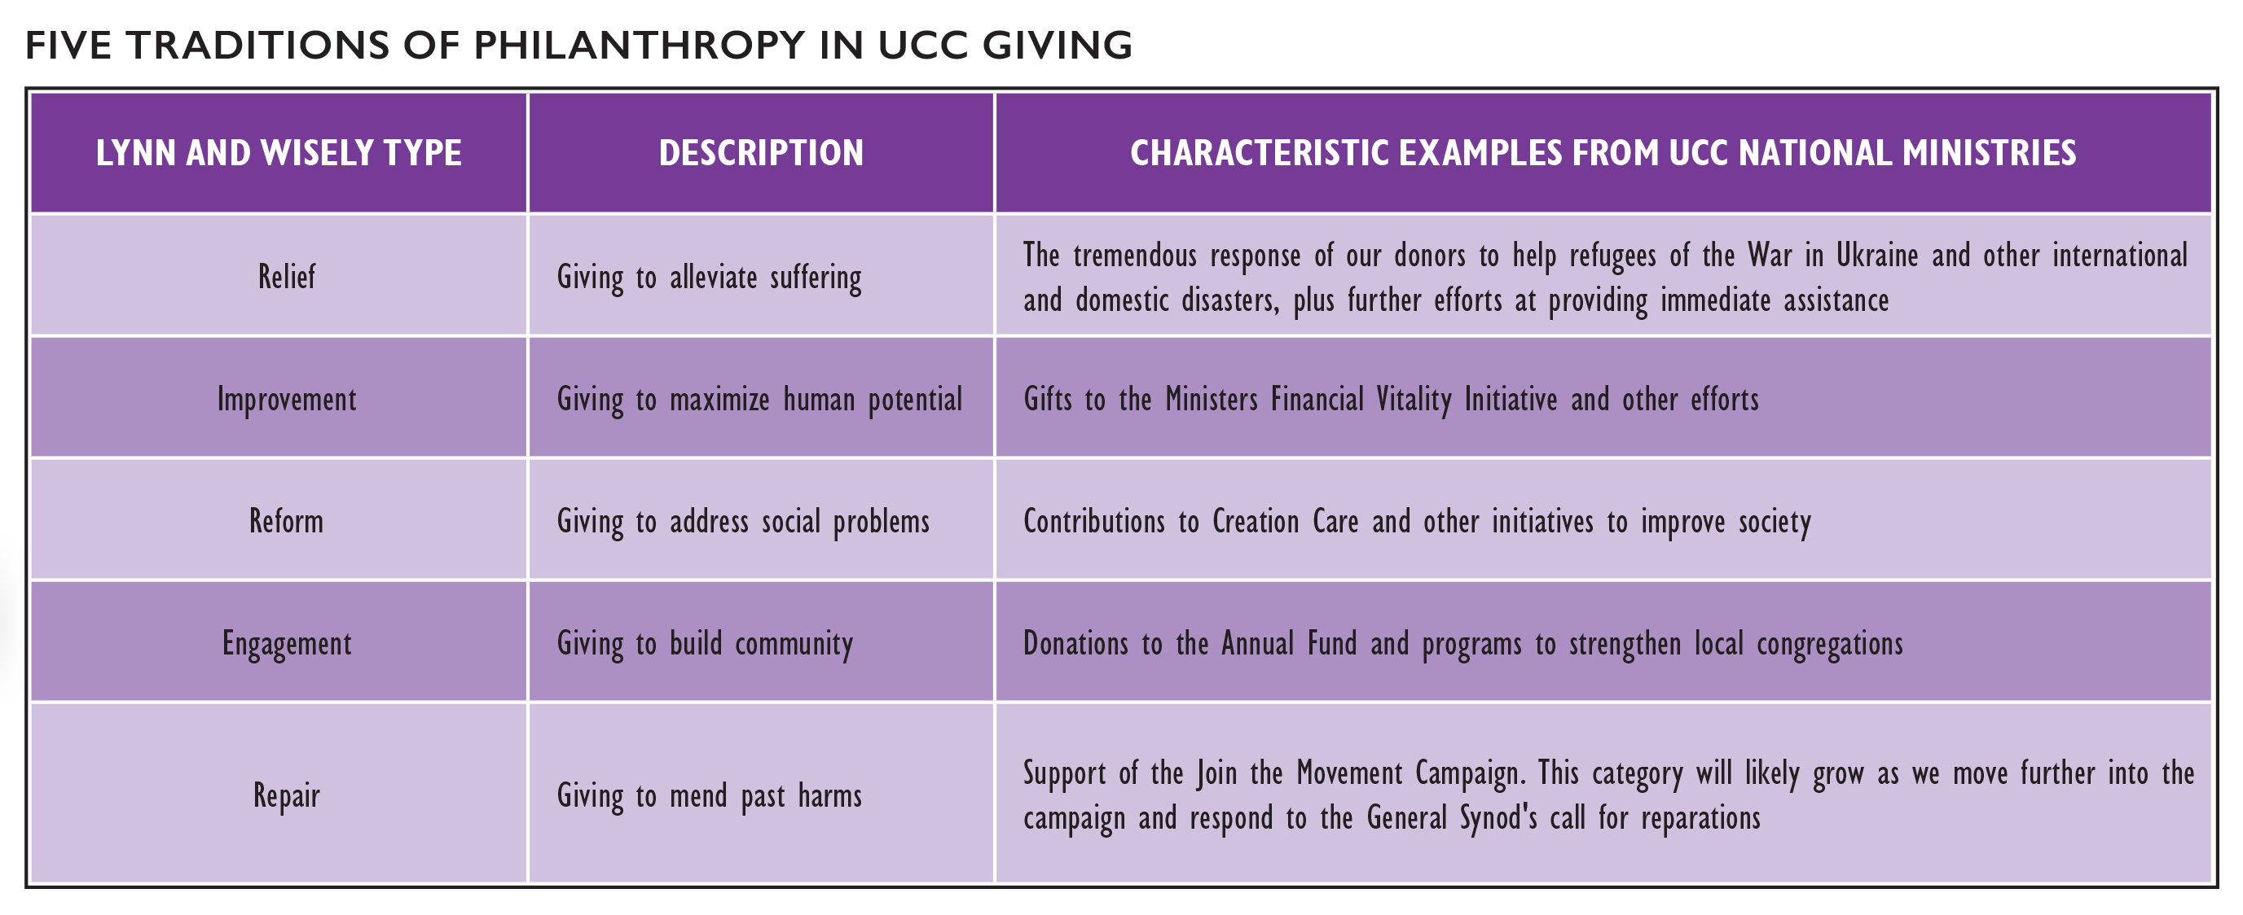

Slide 39
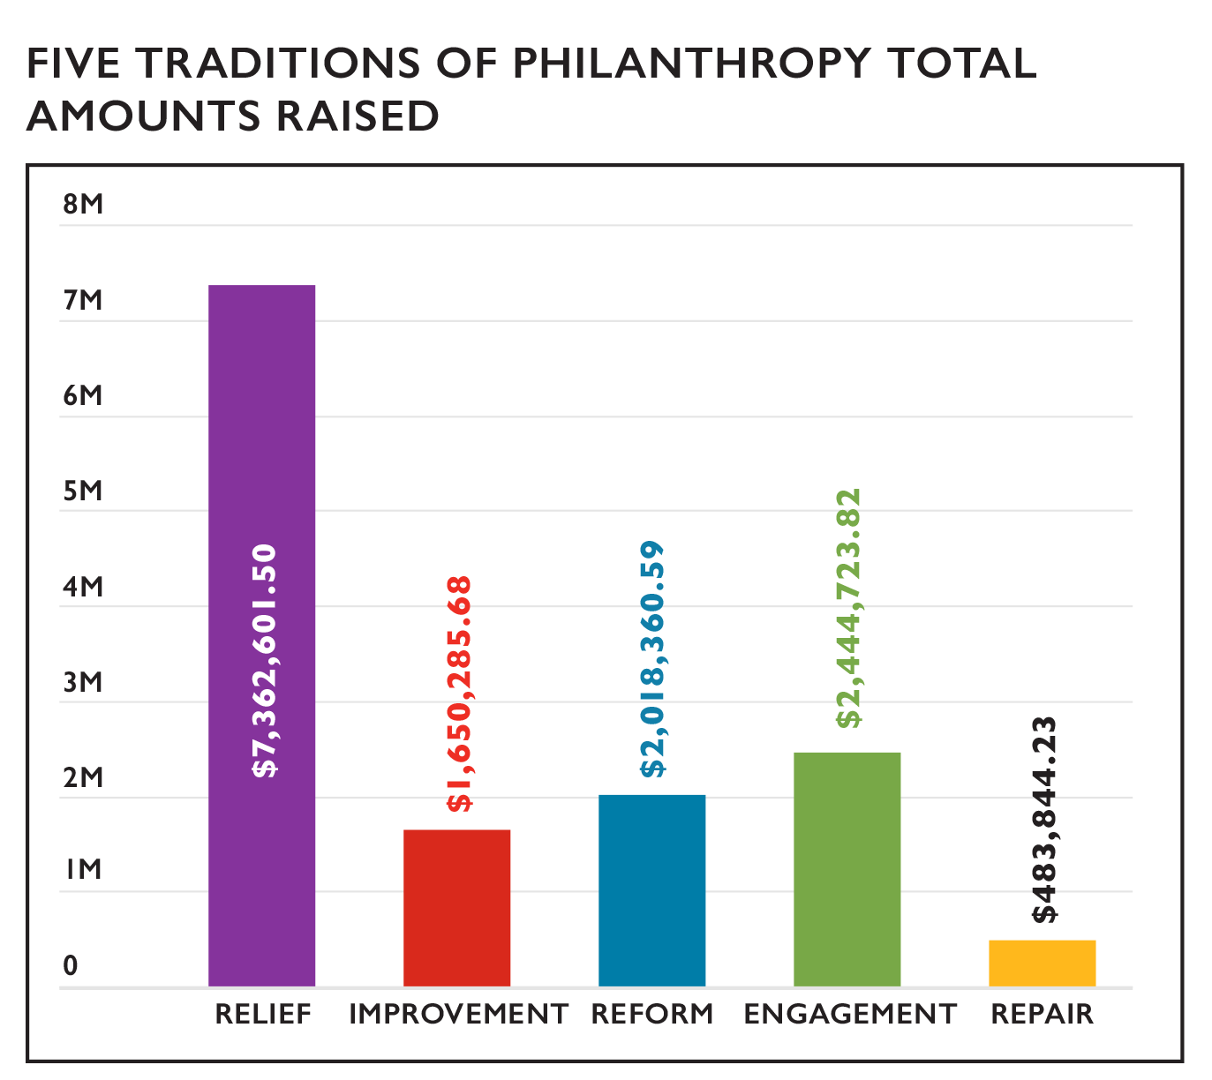
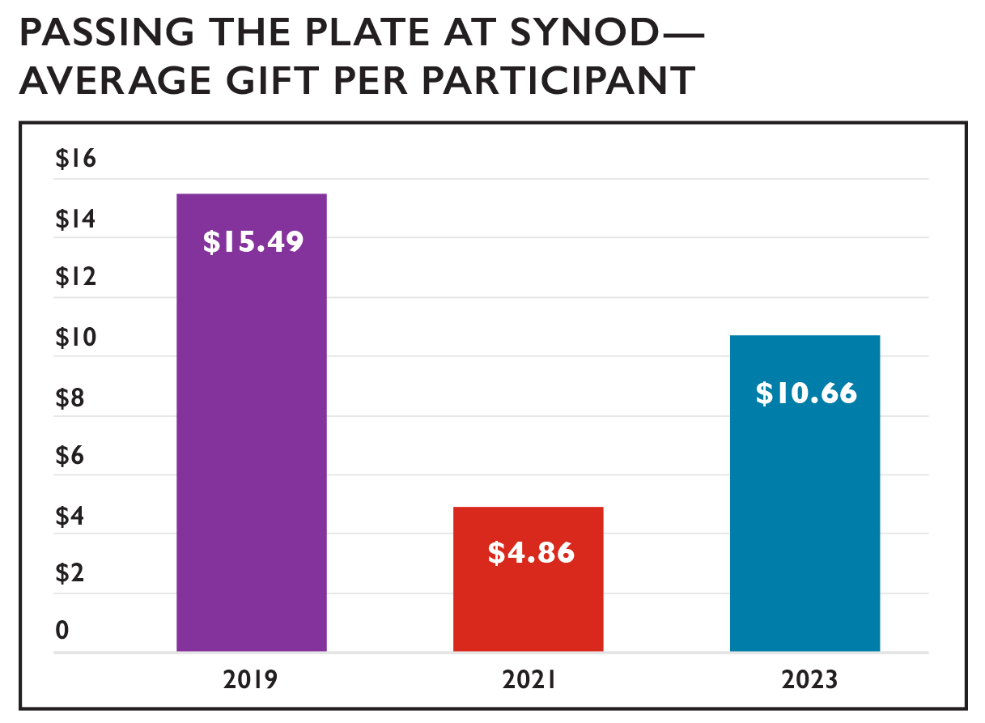

Slide 40
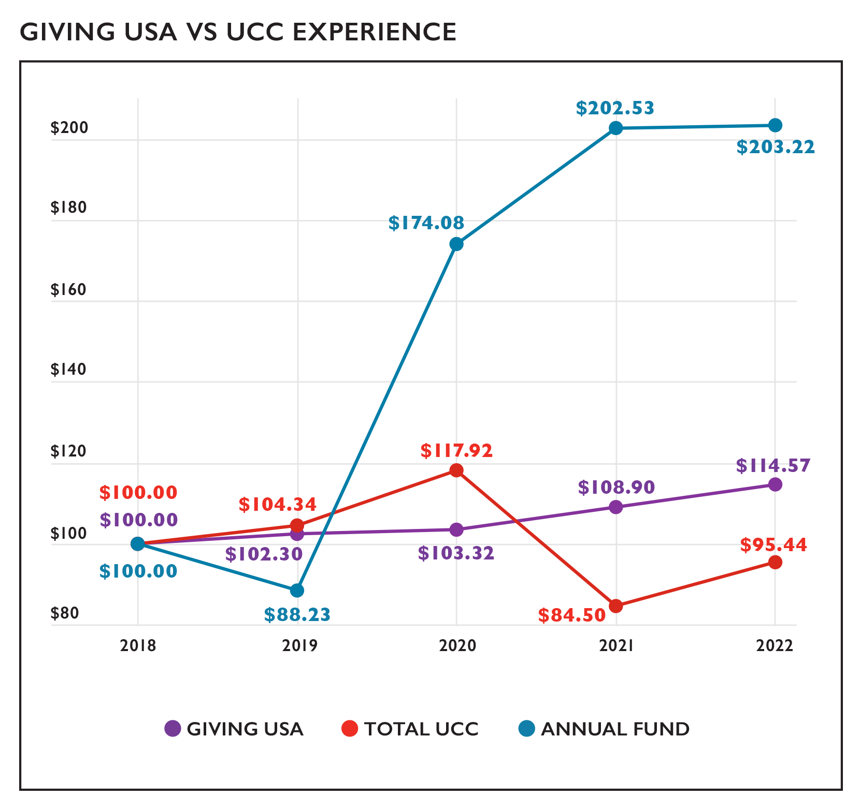

Slide 41
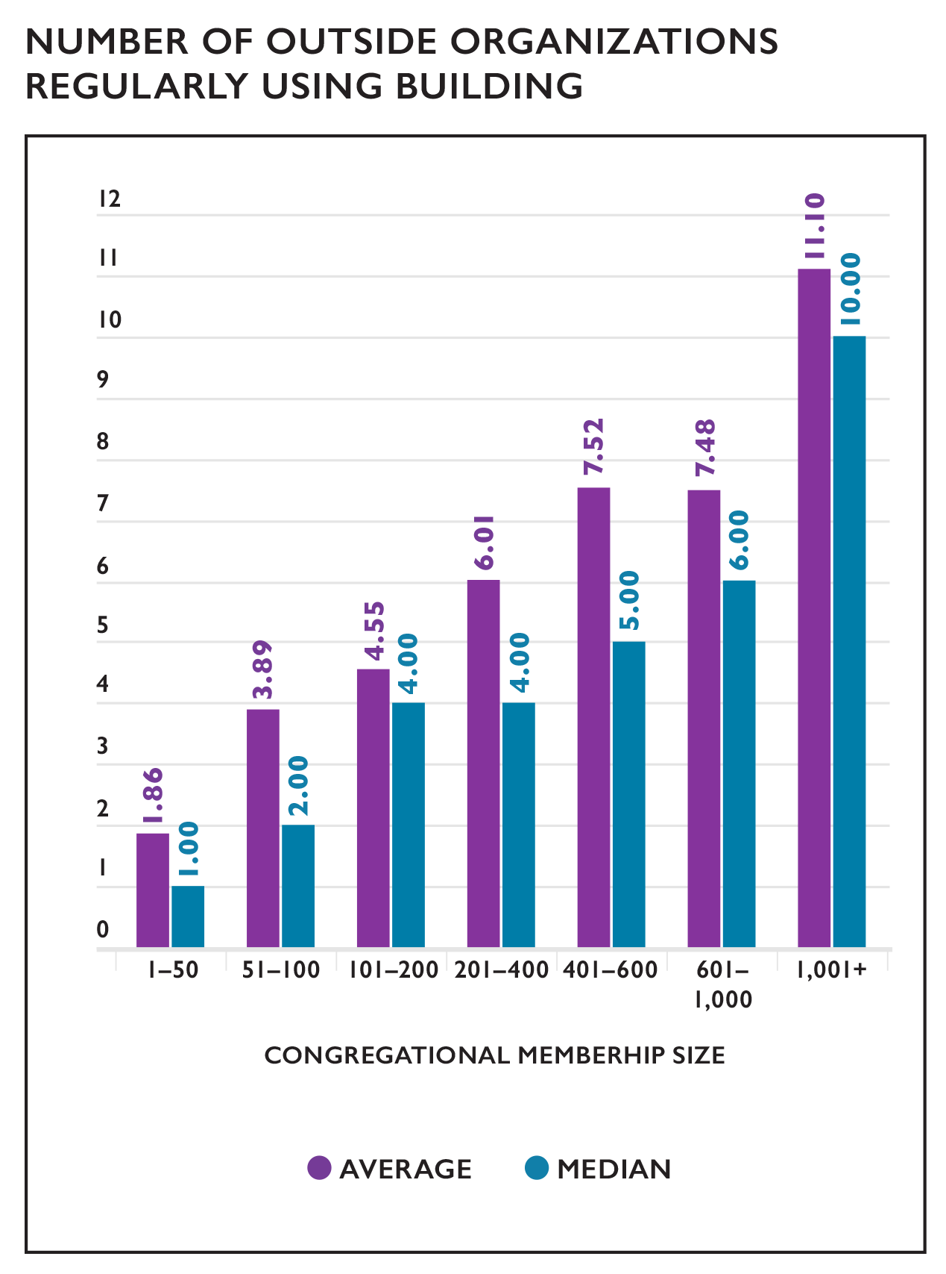

Slide 42
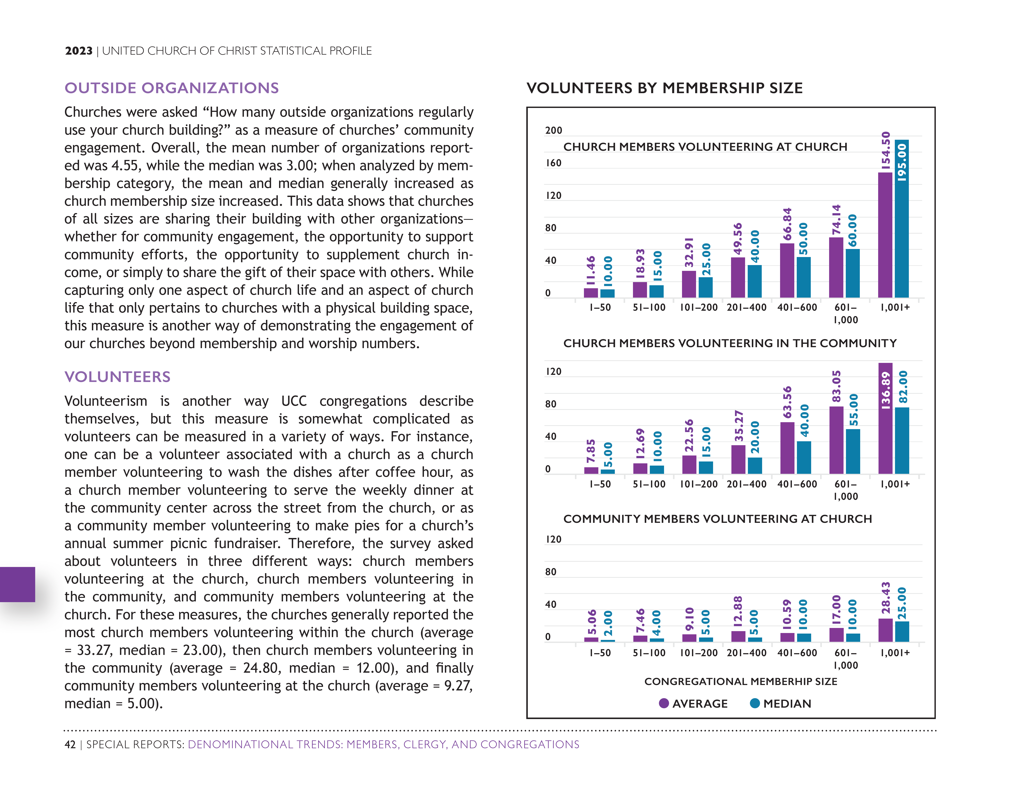
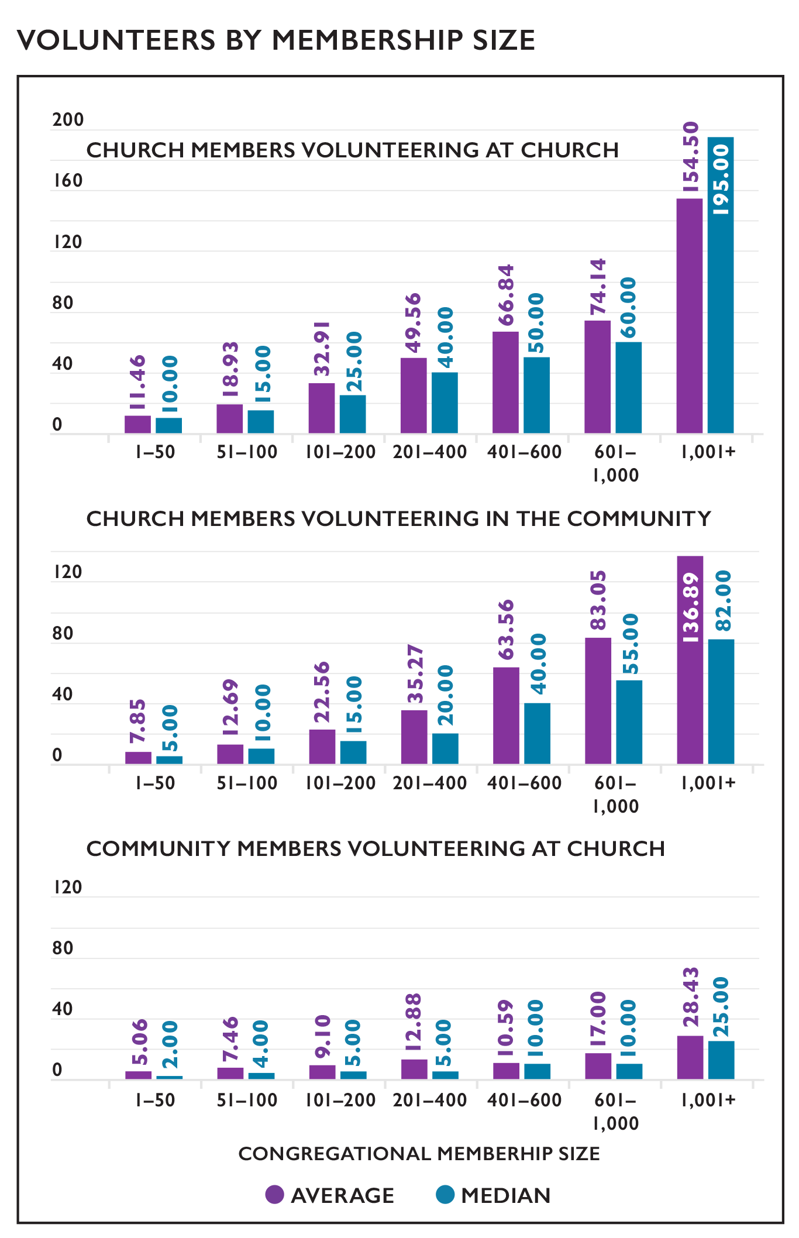

Slide 43
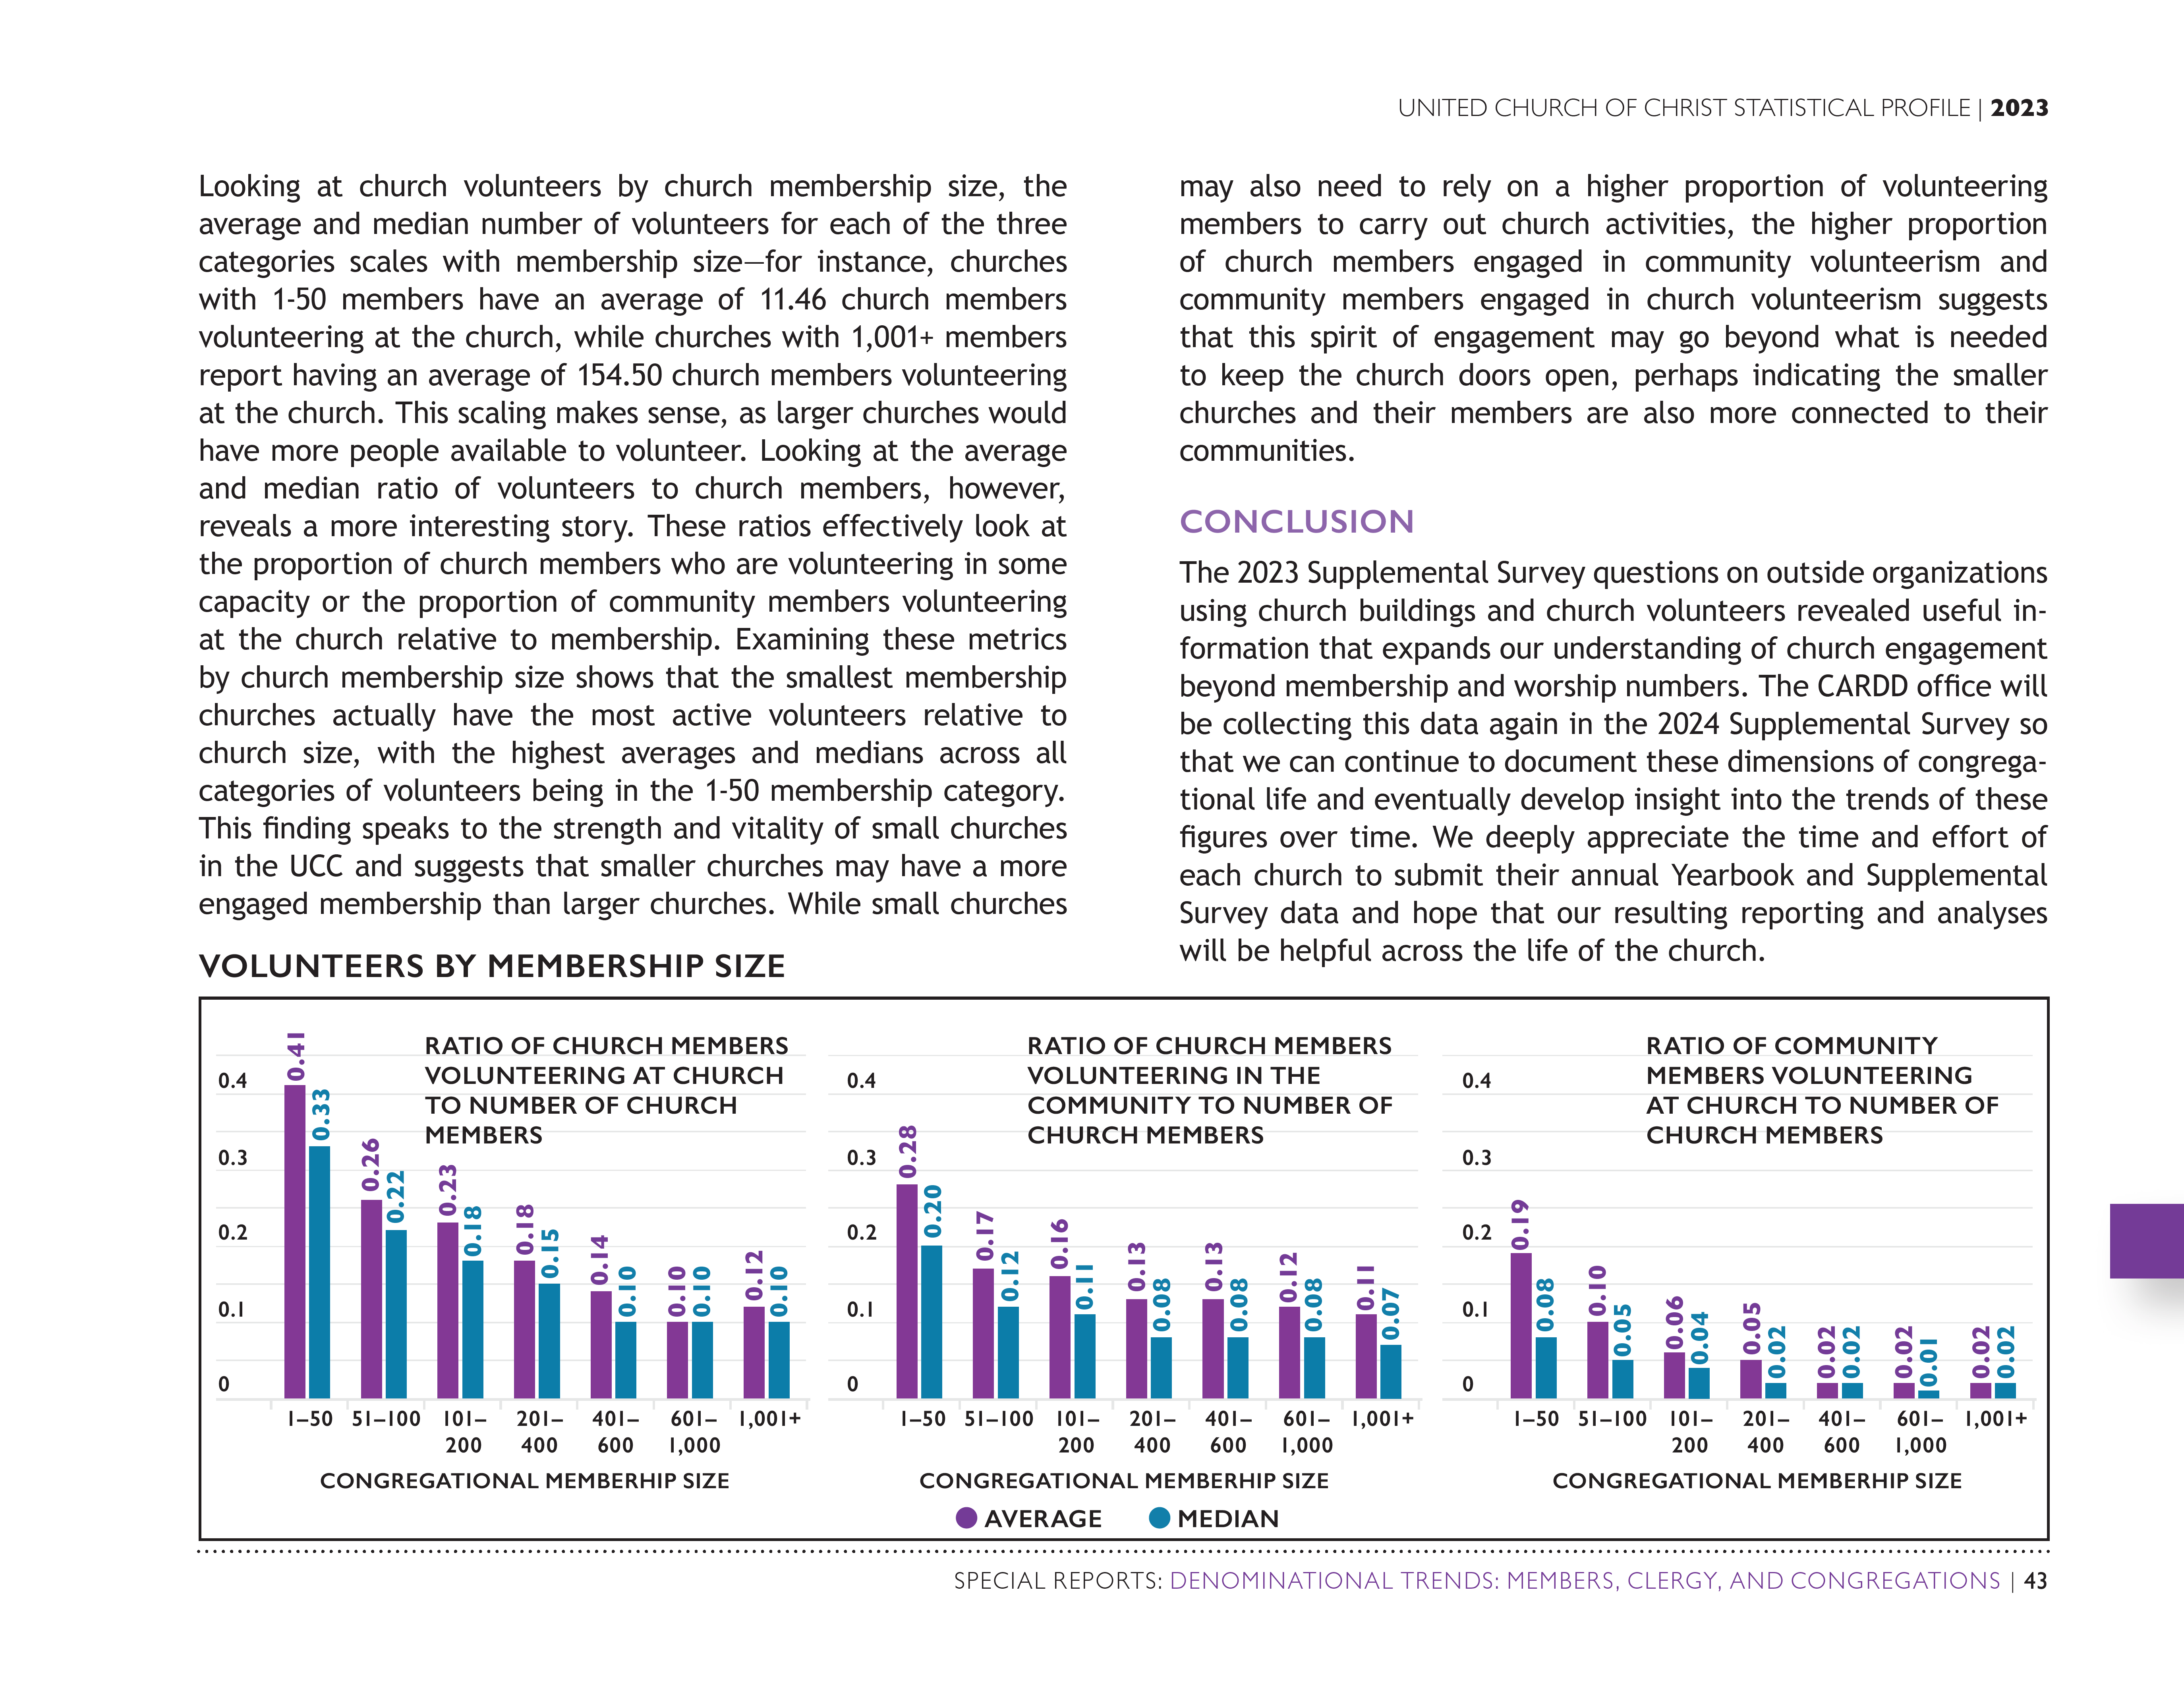

Slide 46
Special Reports Section UCC Programmatic Work

Slide 47
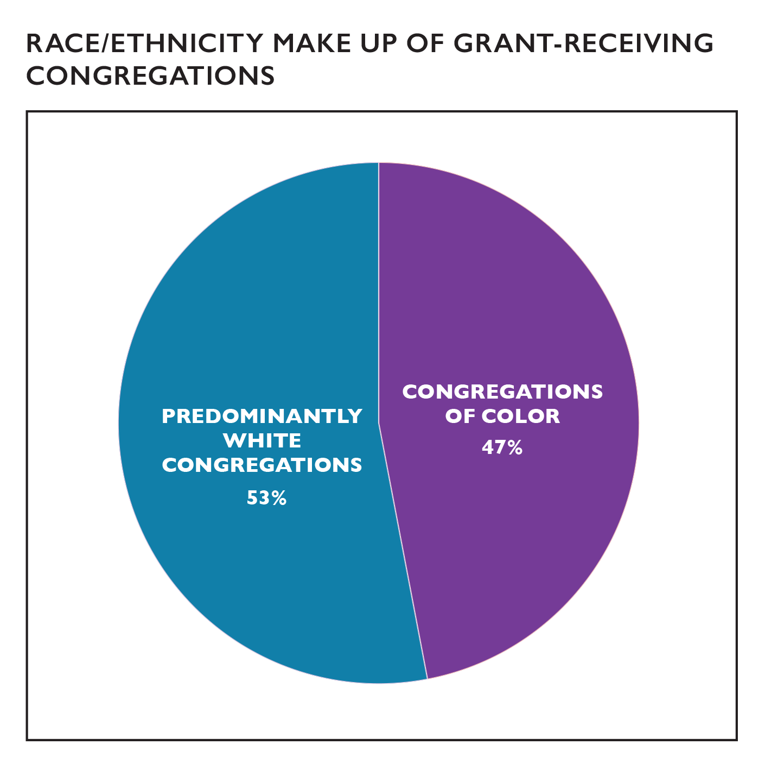

Slide 48
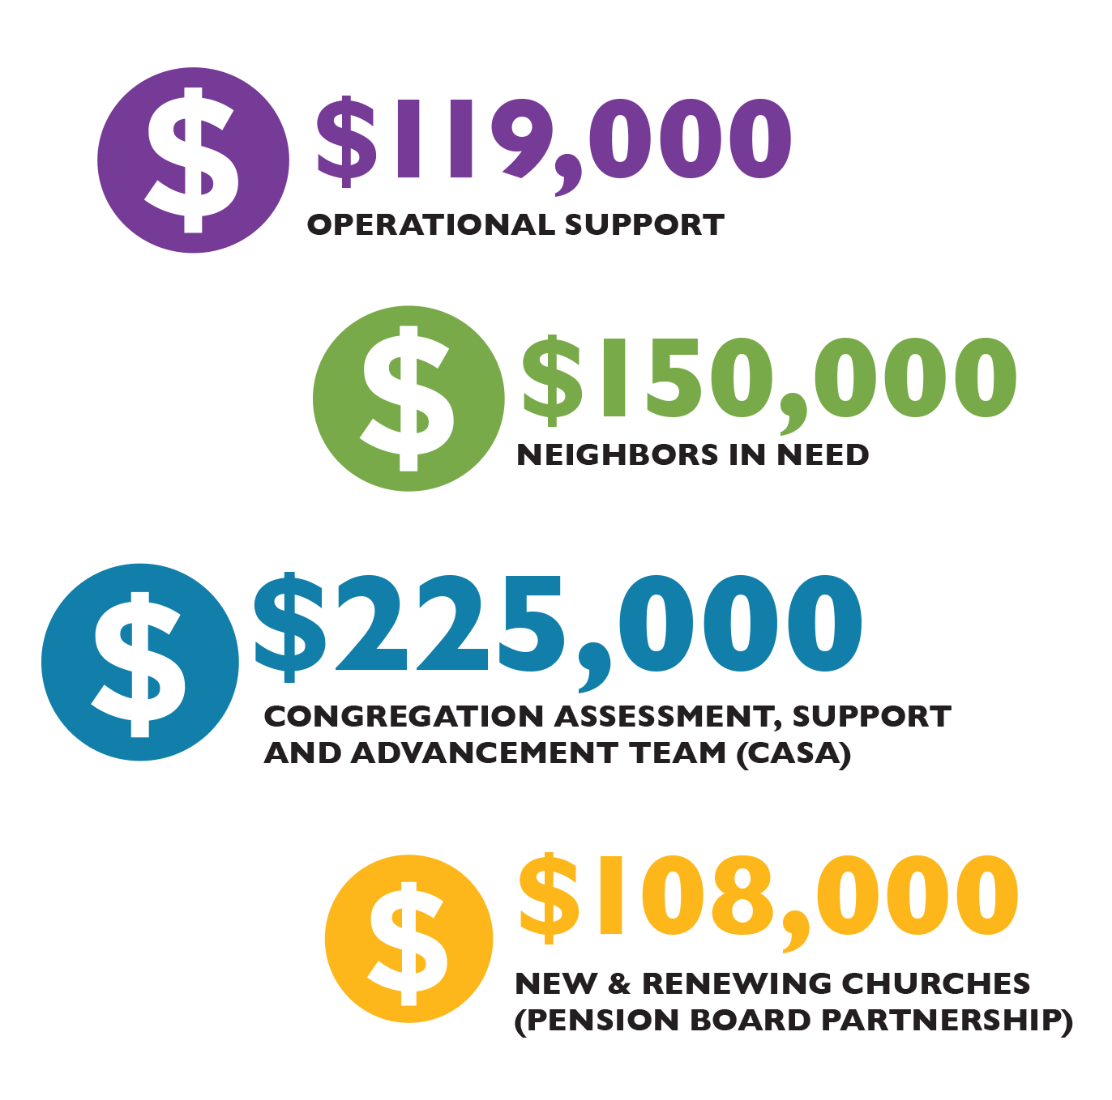

Slide 49
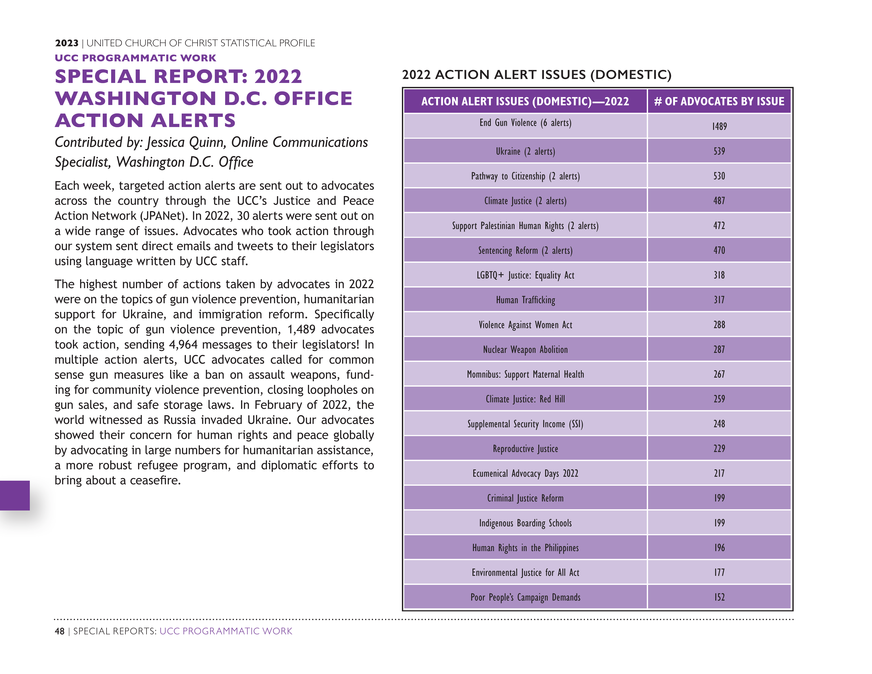
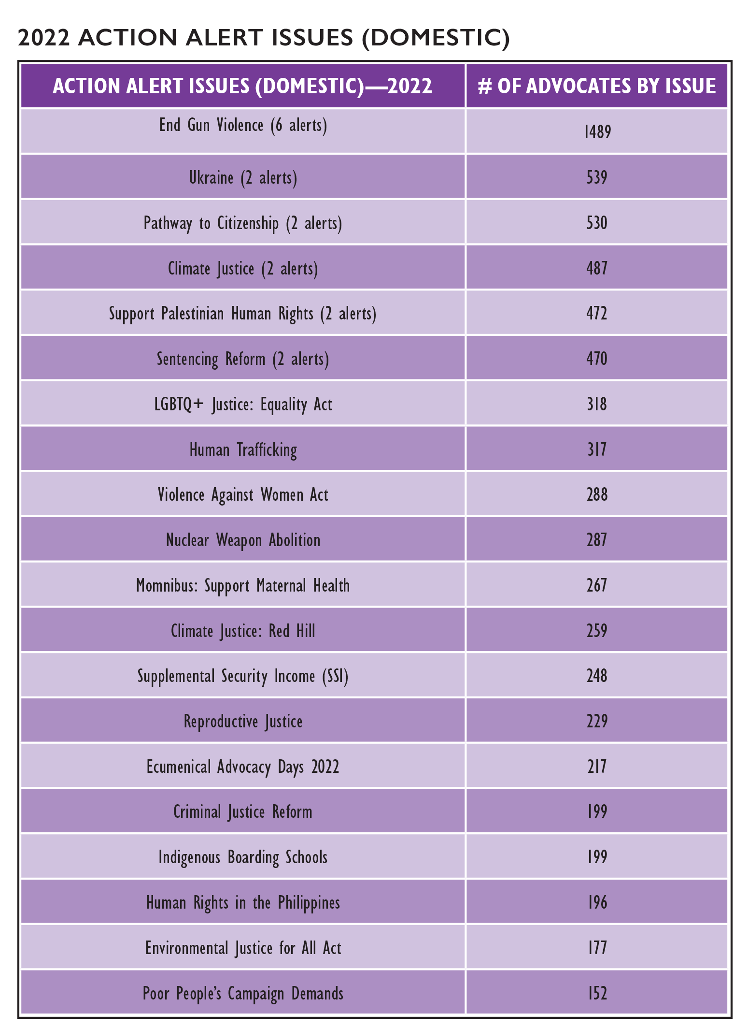

Slide 50
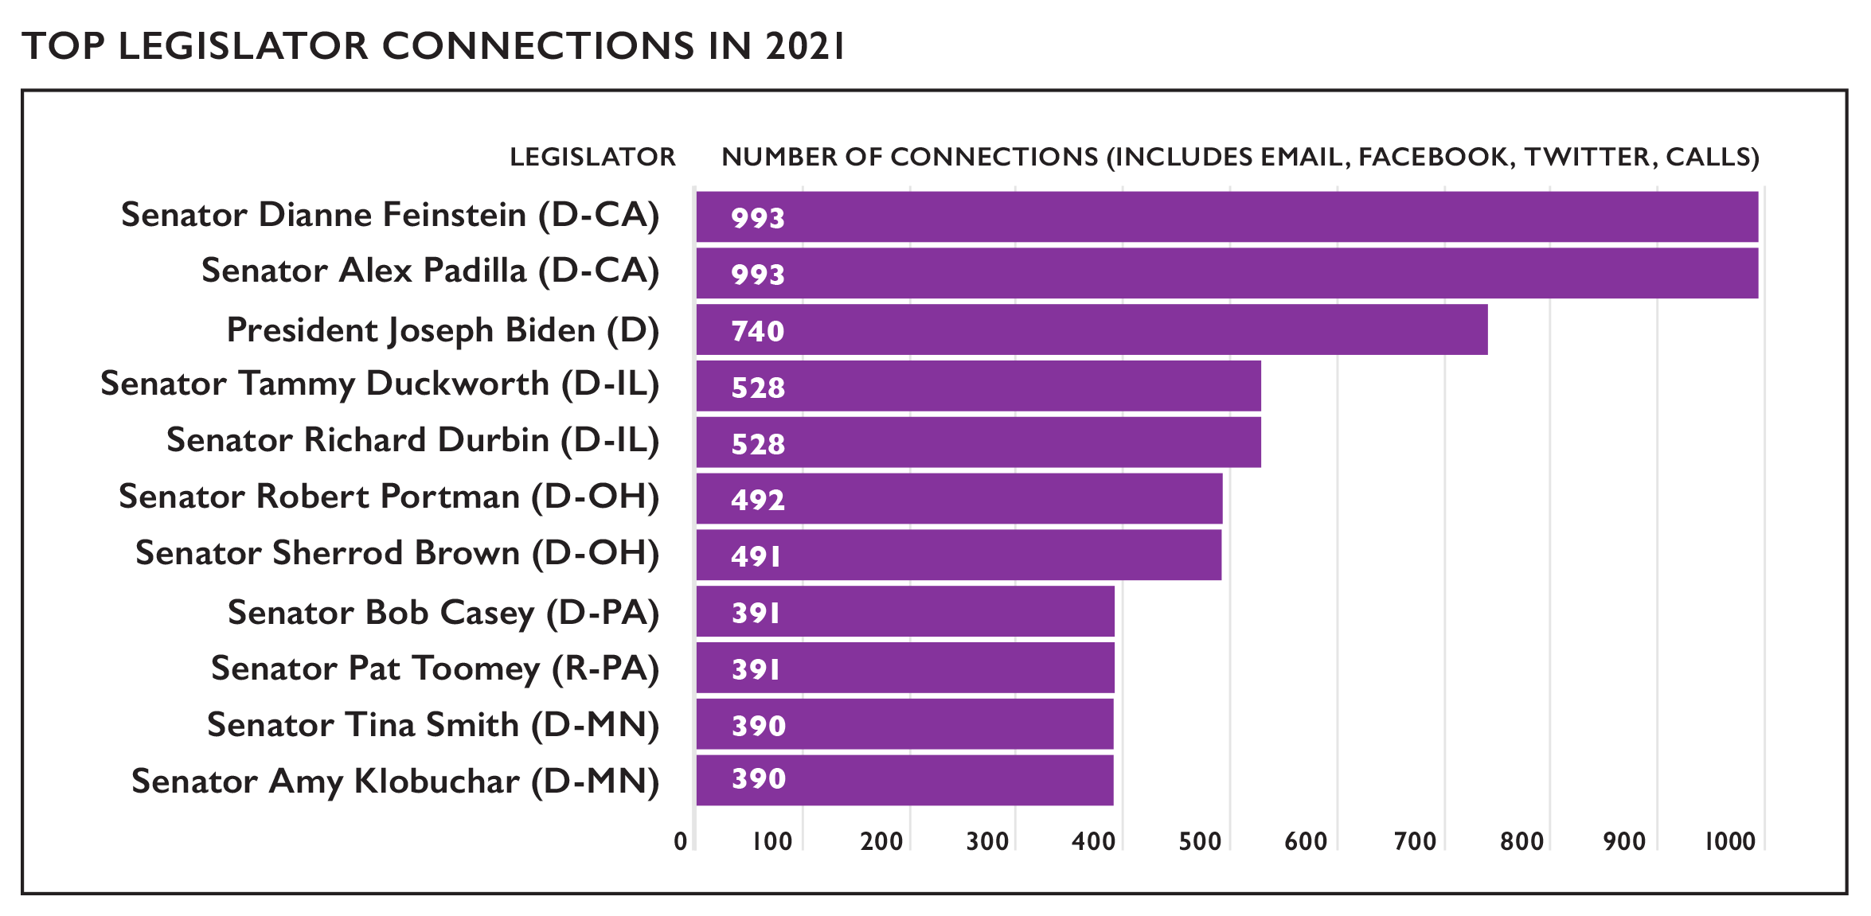
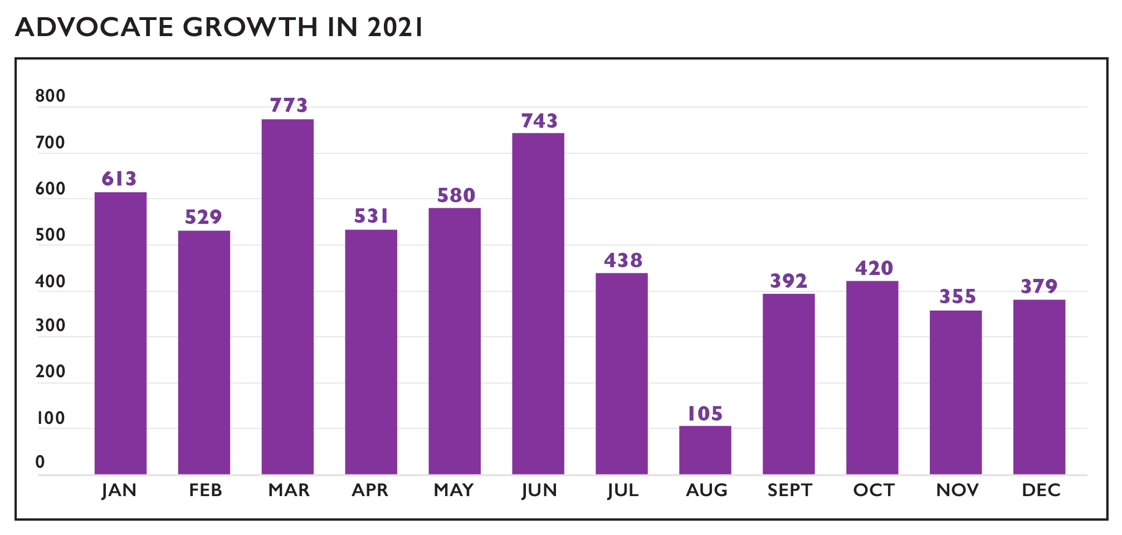

Slide 61
Special Reports Section Reports from Affiliated Ministries

