Slide 1
Visions of Authorized Ministry: Present and Future
Authorizing Ministry for the 21st Century
Thursday, December 1, 2016
Rev. Kristina Lizardy-Hajbi, Ph.D.
Center for Analytics, Research and Data (CARD)

Slide 2
Authorized Ministry Today
Authorization | Active, Non-Retired | Retired | TOTAL
Ordained | 6,022 | 3,950 | 9,972
Licensed | 664 | 13 | 677
Dual | 316 | -- | 316
Ordained Ministerial Partner Standing | 138 | -- | 138
Commissioned | 126 | 24 | 150
TOTAL | 7,266 | 3,987 | 11,253
Out of 746 Members in Discernment, 101 (13.5%) are Licensed.
Notes:
What does ministry look like in the UCC, today and into the future? I know as well as anyone that statistics only tell a part of the story; but they nevertheless provide some critical insights, and prompt us to ask important questions of both our ministry processes and our practices.

Slide 3
Noteworthy Trends toward the Future
Increased number of:
  Retiring/retired ministers
  Female ministers
  Ministers of color
  Ministers under 40
  Retired ministers serving in ministry settings
  Chaplaincy positions
Decreased number of:
  Commissioned ministers
  Local church positions
  Full-time positions
  Ordinations
Notes:
Increased number of:
Retiring ministers – Half of all active Authorized Ministers are over 60, and they will retire in the next decade. Of all Ordained Ministers, 40% are currently Retired. How are we preparing for this sizeable shift?
Female ministers – 49% of all current Authorized Ministers are female; and with our current Member in Discernment pool reflecting a nearly two-thirds female majority, it will only be a few years until there are more female ministers in the UCC. Males, however, continue to receive the vast majority of full-time solo and senior pastorate positions in our churches. Have we examined patriarchal systems and structures and worked to eliminate bias toward female and trans ministers?
Ministers of color – While 88% of all active Authorized Ministers are identified as Euro-American, only 80% of our Member in Discernment pool identify as white. How are we supporting and empowering ministers and members in discernment of color to lead in faithful and sustainable ways?
Ministers under 40 – It appears that the percentage of ministers under 40 serving in senior and solo positions is increasing over time, and this trend will continue; however, ministers under 40 will also continue to constitute a significant minority in the UCC, who are currently only 8% of all active, Authorized Ministers. How are we providing these ministers with real, non-tokenized opportunities for leadership in the church?
Chaplaincy positions – The need for military and other types of chaplains has increased significantly—in the last decade, the number of chaplains have increased by at least 30%. How is the work of these ministers being acknowledged and supported in our respective settings?
Retired ministers serving in ministry settings – More and more, retired ministers are stepping up to serve in interim, part-time, or designated-term positions across our denomination when there is need. How are we ensuring that their gifts and talents are not being exploited for the sake of convenience?
Decreased number of:
Commissioned ministers – In the 1970s and 80s, there was an uptick in the number of Commissioned Ministers in the UCC due to various factors; and in the 1990s and 2000s, the number has remained relatively steady. Now, we are seeing an incremental decrease as these individuals retire in larger numbers. What does this signal to us in our collective understanding of call around specific gifts and skills?
Local church positions – This decrease is no secret and will continue into the future. How are we inviting ministers and MIDs to explore ministry beyond the walls of a church building?
Full-time positions – Currently, at least one-third of all senior/solo local church pastorates are part-time; this will increase in coming years. How are the roles and expectations of part-time positions shifting appropriately? How are we preparing ministers for the realities of bi-vocational ministry?
Ordinations – While there are decreases in the number of ordinations in recent years, an on-going downward trend remains to be seen. What are other ways that leadership and calling are being nurtured in our midst? Is the nature of call changing, or just the context?

Slide 4
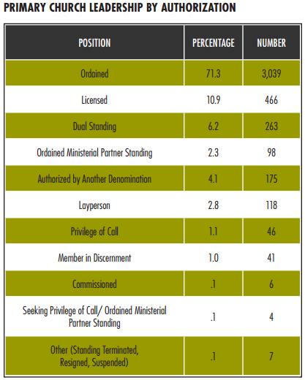
Who Is Leading UCC Congregations?
Ordained = 71.3%
Licensed = 10.9%
Authorized previously or primarily by / in conjunction with another denomination = 13.8%
Layperson = 2.8%
Notes:
In taking a closer look at leadership in UCC churches, we see that 7 in 10 congregations employ a UCC Ordained Minister as primary leadership. It is interesting to note that not only 1 in 10 solo/senior pastors Licensed, but 13.8% are ministers authorized by/with another denomination. How is this shifting the nature—the fabric—of our congregations? How does the percentage of ministers authorized by another denomination impact the nature of “denominational loyalty”, positively and negatively?

Slide 5
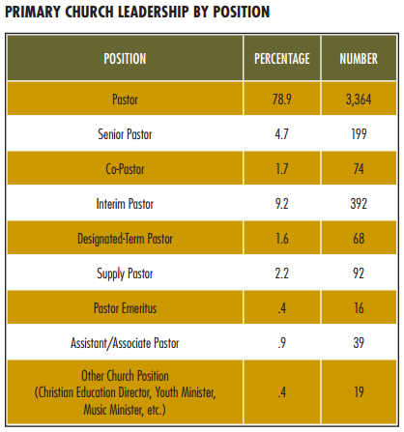
Who Is Leading UCC Congregations?
In transition (Interim or Designated-Term)= 10.8%
If Other Church Position, Pastor Emeritus, Associate/ Assistant, and Supply are included = 14.7%
Notes:
In addition, at any one point in time, at least 10% of our congregations are experiencing transition at the solo/senior leadership level. What impact is this having on not only the congregations themselves, but also the association, conference, and national setting? With increased transitions being expected in future years due to retirements, how as a denomination will we respond to this culture of transition that is establishing itself among us?

Slide 6
Ministerial Excellence/Formation
Research on the Relationship between Marks and Congregational Vitality Factors
Four Marks correlated significantly with the greatest number of congregational vitality indicators:
  The ability to mutually equip and motivate a community of faith
  The ability to lead and encourage ministries of evangelism, service, stewardship, and social transformation
  The ability to read the context of a community’s ministry and creatively lead that community through change or conflict
  The ability to frame and test a vision in community
These four marks were the lowest-rated by congregants.
Ministry-related knowledge and skills (preaching, Biblical interpretation, pastoral care, leading worship) were most valued by congregants but demonstrated a much weaker relationship with congregational vitality.
Notes:
And finally, one more item for thought: In research conducted by our office two years ago, we examined the relationship between the Marks of Faithful and Effective Authorized Ministers and factors of congregational vitality. The following four Marks correlated…
A report confirming these findings was just released last week by the Association of Theological Schools, which stated that “graduates perceive theological education to be effective in helping them think theologically, but somewhat ineffective in preparing them to administer and lead a parish.”
What is required to prepare people to lead—or better yet, to thrive in leadership--in this time and place? What will be required of our leaders in the future? Is what we are teaching leading to the nurturing of faith-filled communities and organizations that are dynamic, adaptive, and vital?

Slide 7
Current and Future Research Trends
Specialized Ministries
Search and Call: Demographically, who is getting church positions? What kinds of positions?
  Gender
  Race
  Ability
  Sexual orientation
Flourishing in Ministry Project: Well-being of Clergy in the UCC
  Partnership with the University of Notre Dame: http://wellbeing.nd.edu/flourishing-in-ministry/
Notes:
These trends lead us to ask all of these questions and more. And while we cannot predict the future, we can use our past and present as a guide for preparing the United Church of Christ for the already and the not yet, the eschatalogical realities we face. CARD’s ministry will continue to explore various aspects and trends in ministry, some of which include gaining a better demographic picture of search and call and partnering with other entities to explore ministerial well-being the UCC and beyond. Thank you.

